Slide 1



Digital skills: the key of the future
School Accreditation 2024-1-IT02-ka121-SCH-000213329
Group School Mobility
Valencia 6th-12th April 2025

Slide 2

WHAT ARE DIGITAL SKILLS?
Digital skills are the skills needed to "use digital devices, communication applications and networks to access and manage information", from basic online research to programming. These skills help people to communicate and collaborate, develop and share digital content and solve problems.

Slide 3

Why are they important?
Digital skills are essential in schools because they prepare students and teachers for an increasingly technological and interconnected world. Here’s why they are important:
For the students:
Preparing for the future: Digital skills are essential to tackle the world of work, where technology plays a central role.
Active learning: Digital tools such as online platforms, educational software and multimedia resources make learning more engaging and personalized.
Critical thinking: Knowing how to evaluate online sources and using media consciously helps students develop analytical skills and avoid misinformation.
For teachers:
Innovative teaching: The digital skills allow to integrate new methodologies, such as flipped classroom or project-based learning, making lessons more effective.
Classroom management: Digital tools facilitate communication with students, progress assessment and the organization of teaching materials.
Continuing training: Teachers with digital skills can constantly update themselves and keep up with new educational technologies.

Slide 4

Computational Thinking
Computational thinking is like having a map to solve complex problems. It teaches you:
Break down problems: Divide a big problem into smaller pieces that are easier to deal with.
Finding patterns: Recognize patterns that repeat themselves to understand how things work.
Automate solutions: Create instructions (algorithms) to solve problems quickly and accurately.
This skill is not only for those who want to work with computers: it is useful in every field, from mathematics to everyday life, because it helps you think in a logical and creative way.

Slide 5

Critical and Conscious Use of Social Networks
Social networks are like a virtual square: full of opportunities,but also risks. Here’s how to use them intelligently:
Ask yourself questions: Who wrote this post? What’s the point? Is it true news or a hoax?
Protect your privacy: Do not share personal information with anyone and use appropriate security settings.
Be polite: Communicate with respect, avoiding offensive or aggressive comments.
With these little attentions, you can turn social media into a useful and safe tool, rather than a source of stress or misinformation.

Slide 6
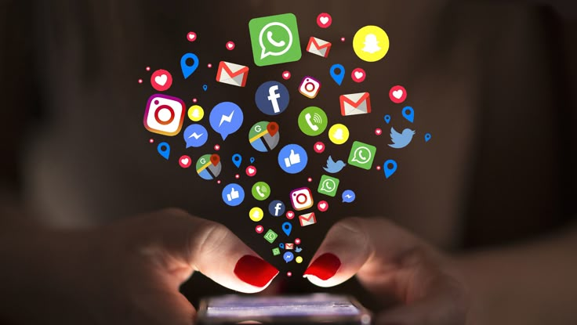
Conscious USE OF Media
Navigating the digital world is like being a detective: you need to be able to distinguish between true and false information. Here's how to do it:
Verify sources: Check who wrote the article and whether it is reliable.
Analyze messages: Try to understand what they want to communicate and whether there is a hidden intent.
Share responsibly: Before sharing a news item, make sure it is true and useful.
This approach helps you avoid falling into the traps of disinformation and become a more conscious digital citizen

Slide 7

Future Trends in Digital Education
The future of learning will be increasingly technological and personalized:
Tailored learning: Thanks to artificial intelligence, each student will be able to follow a path suited to their needs.
Virtual and augmented reality: Imagine taking a history lesson by visiting a medieval castle in 3D or studying biology by exploring the human body in virtual reality.
Microlearning: Small pills of knowledge that you can study whenever you want, even for just a few minutes.
These innovations will make learning more fun, engaging and suitable for everyone.

Slide 8


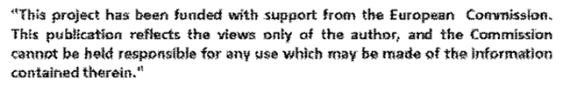
Thank you for your attention
BY Giulia Seminaroti and Sofia Gualtieri

