Slide 1





BASIC SKILLS DEVELOPMENT
FOR INCLUSION
PNRR_2023-1-IT02-KA121-SCH-000126195_20250321_112516
Moreni 5th-10th April 2025
Simone Camillo Dominianni and
Andrea Francesco Montesano

Slide 2

WHAT INCLUSION IS
Inclusion is the process of creating an environment where everyone can improve skills through cutting-edge methods. This is intended to look beyond the box and enable everyone to participate actively. These methods should be consolidated keeping Europeanization, Digitalization, Sustainability in mind. This approach changes the focus from passive learning to the concrete development of personal skills.
Notes:
Note per il relatore:
Descrizione di quanto appreso, con parole tue, su un lato.
Includi informazioni sull'argomento
Qui saranno utili anche i dettagli sull'argomento.
Racconta la tua esperienza di apprendimento. Come qualunque racconto, deve avere un inizio, uno svolgimento e una fine.
Sull'altro lato puoi aggiungere un elemento grafico che dimostri ciò che hai appreso.
Puoi anche usare più diapositive per riflettere sul processo. È utile anche aggiungere un video del processo.

Slide 3

THE SKILLS WE ARE TALKING ABOUT
Basic skills include digital literacy, informal problem solving, communication and cultural competence. Curricula should be intended as complete transversal programs in everyday learning, so as to allow students to evolve in a rich environment and therefore be able to keep up with them in a collaborative environment.

Slide 4
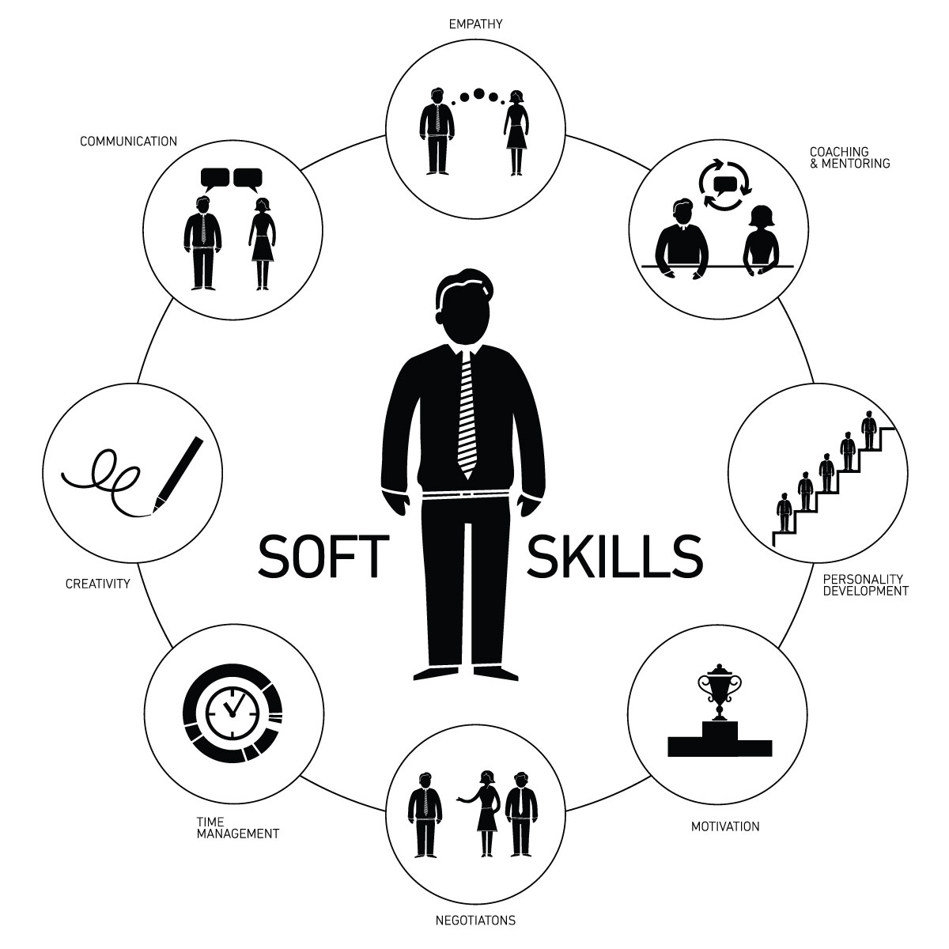
HOW TO USE THESE SKILLS
In order to make the most of these skills, they must be considered as a whole on a daily basis. Educators and organizations should plan learning practices
that consolidate the necessary skills of the individual
using new methods and digital tools.
This criterion not only strengthens imagination and collaboration among students, but
also supports more complex educational purposes
promoting European standards and sustainability. This therefore allows all students to adapt to the changes that the world faces day by day.

Slide 5

THE BENEFITS OF INNOVATIVE SKILLS
The use of innovative programs to
strengthen individual essential skills has several advantages. It is intended in an inclusive environment that tolerates and "rewards" diversity and maintains that the participation of each individual is fundamental. This strategy promotes progress in digitalization and
sustainability within education, but also
strengthens problem-solving abilities,
significantly raising the level of learning and education.

Slide 6

DISADVANTAGES OF INNOVATIVE SKILLS
Using and adding innovative methods in the advancement of basic skills has some disadvantages too. It requires a large amount of investment in cutting-edge technologies and spasmodic professional development. Resistance from some institutions is a second disadvantage that is aggravated by non-unitary access to digital tools. Having to deal with the needs of Europeanization, Inclusion, Digitalization and Sustainability can lead to huge complex economic tasks.

Slide 7

CONCLUSIONS
In conclusion, modern learning and societal advancement rely on fresh, inclusive abilities. Enhancing fundamental competencies with a forward-thinking perspective builds an all-encompassing academic framework that embraces European integration, accessibility, technology, and environmental responsibility. This plan equips individuals for upcoming obstacles while fostering ongoing growth, fairness, and adaptability in a changing environment.

Slide 8
THANK YOU ALL!!!!!
Andrea Francesco Montesano and Simone Camillo Dominianni

