Slide 1



Moreni- 5-10 April 2025
PNRR 2023-1-IT02-KA121-SCH-000126195
Group Mobility of School Pupils
held at Colegiul National „Ion Luca Caragiale” Moreni, Romania
Logbook

Slide 2
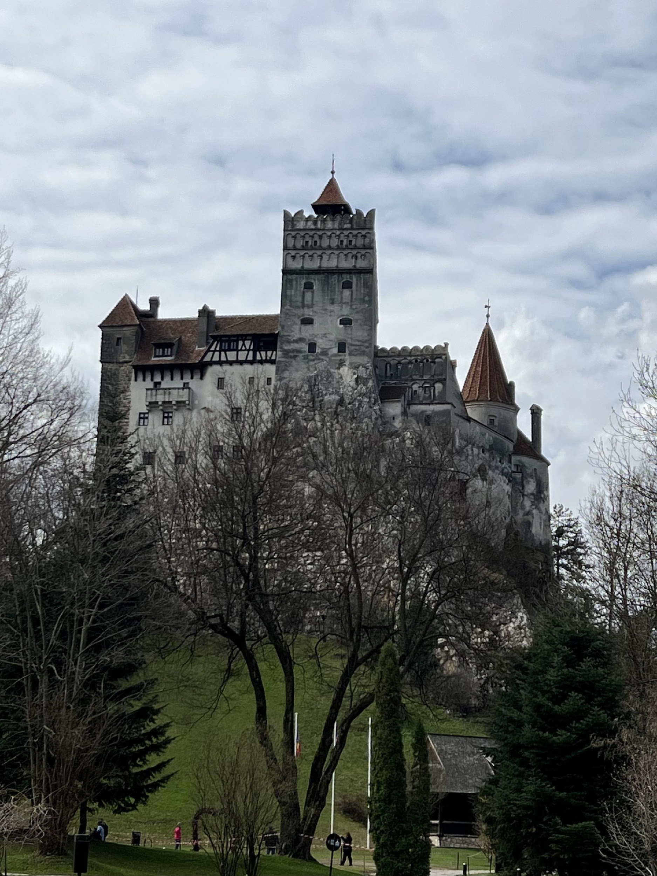
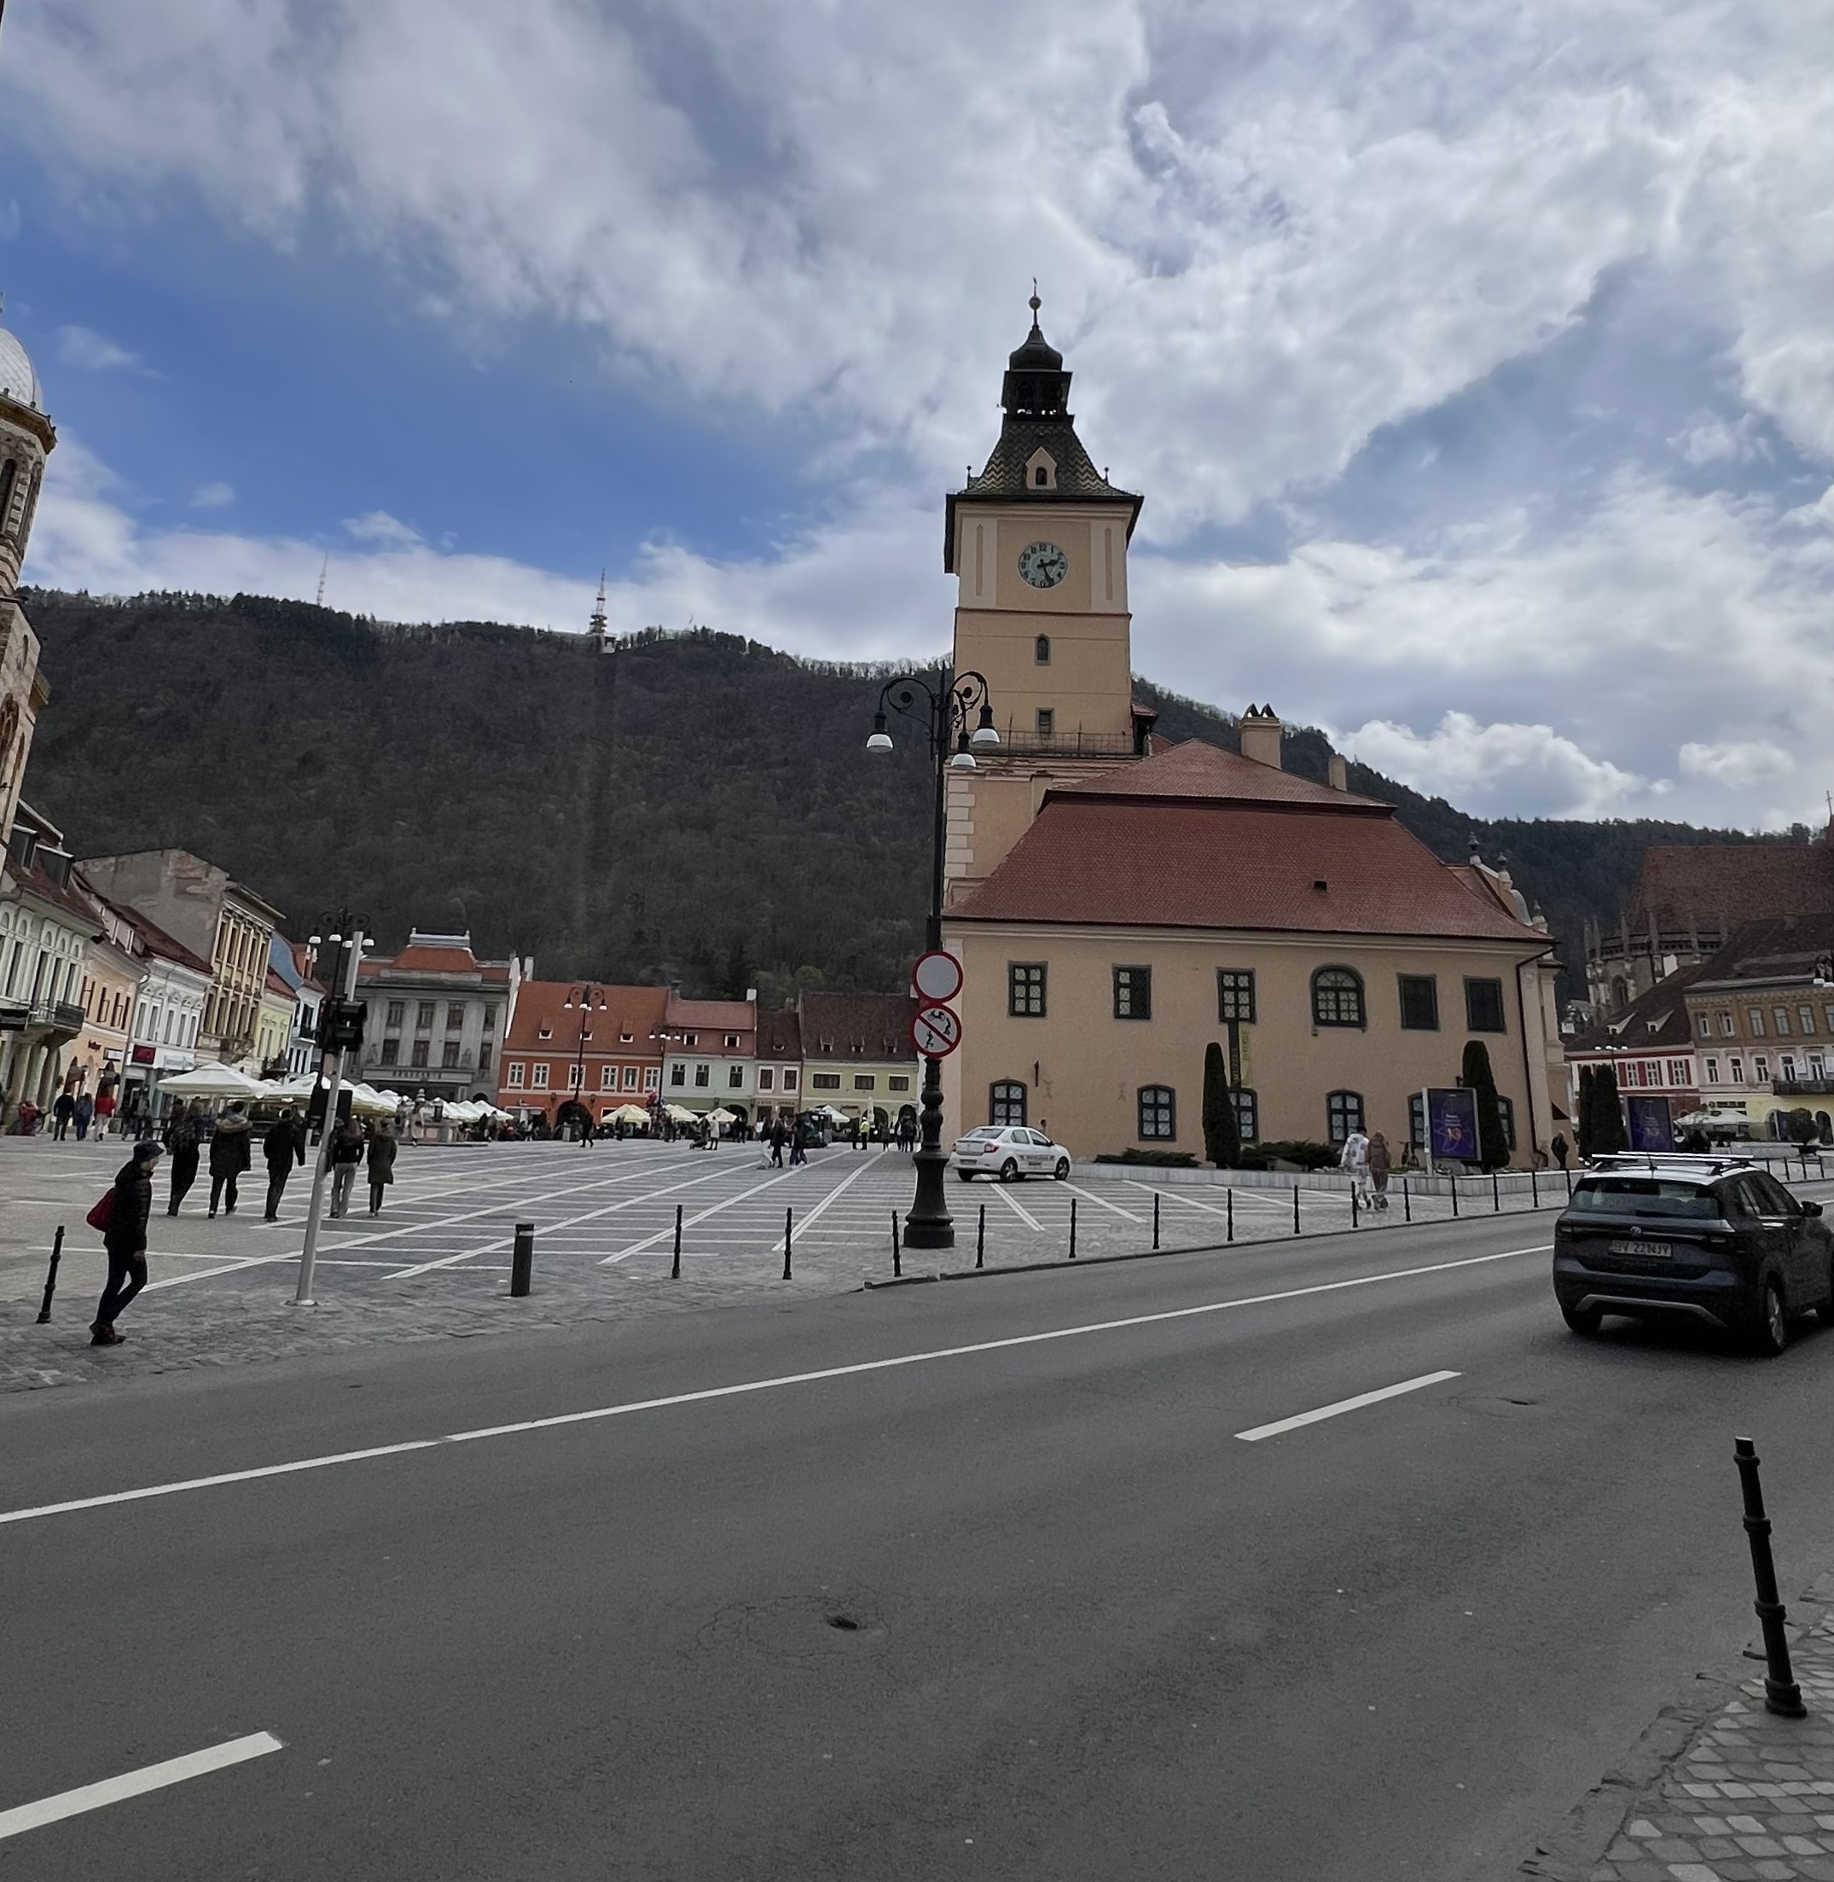
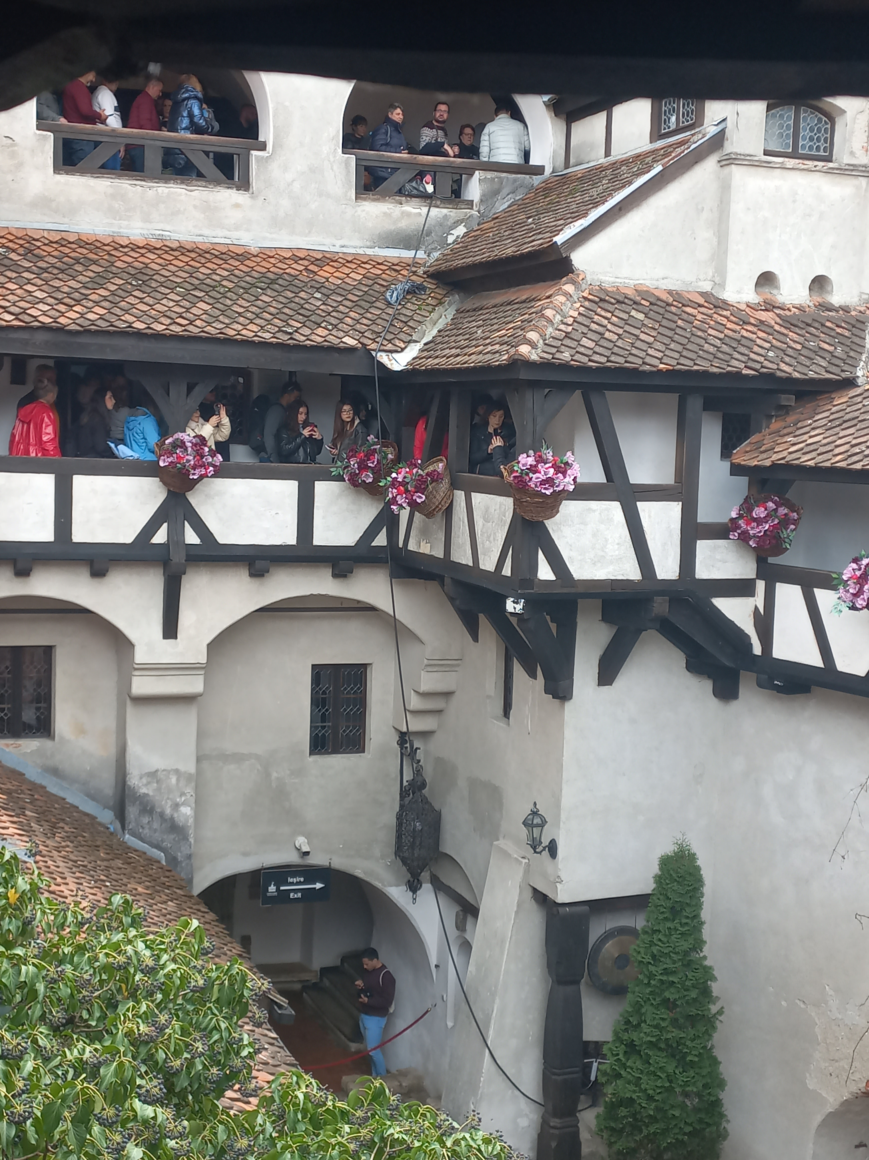
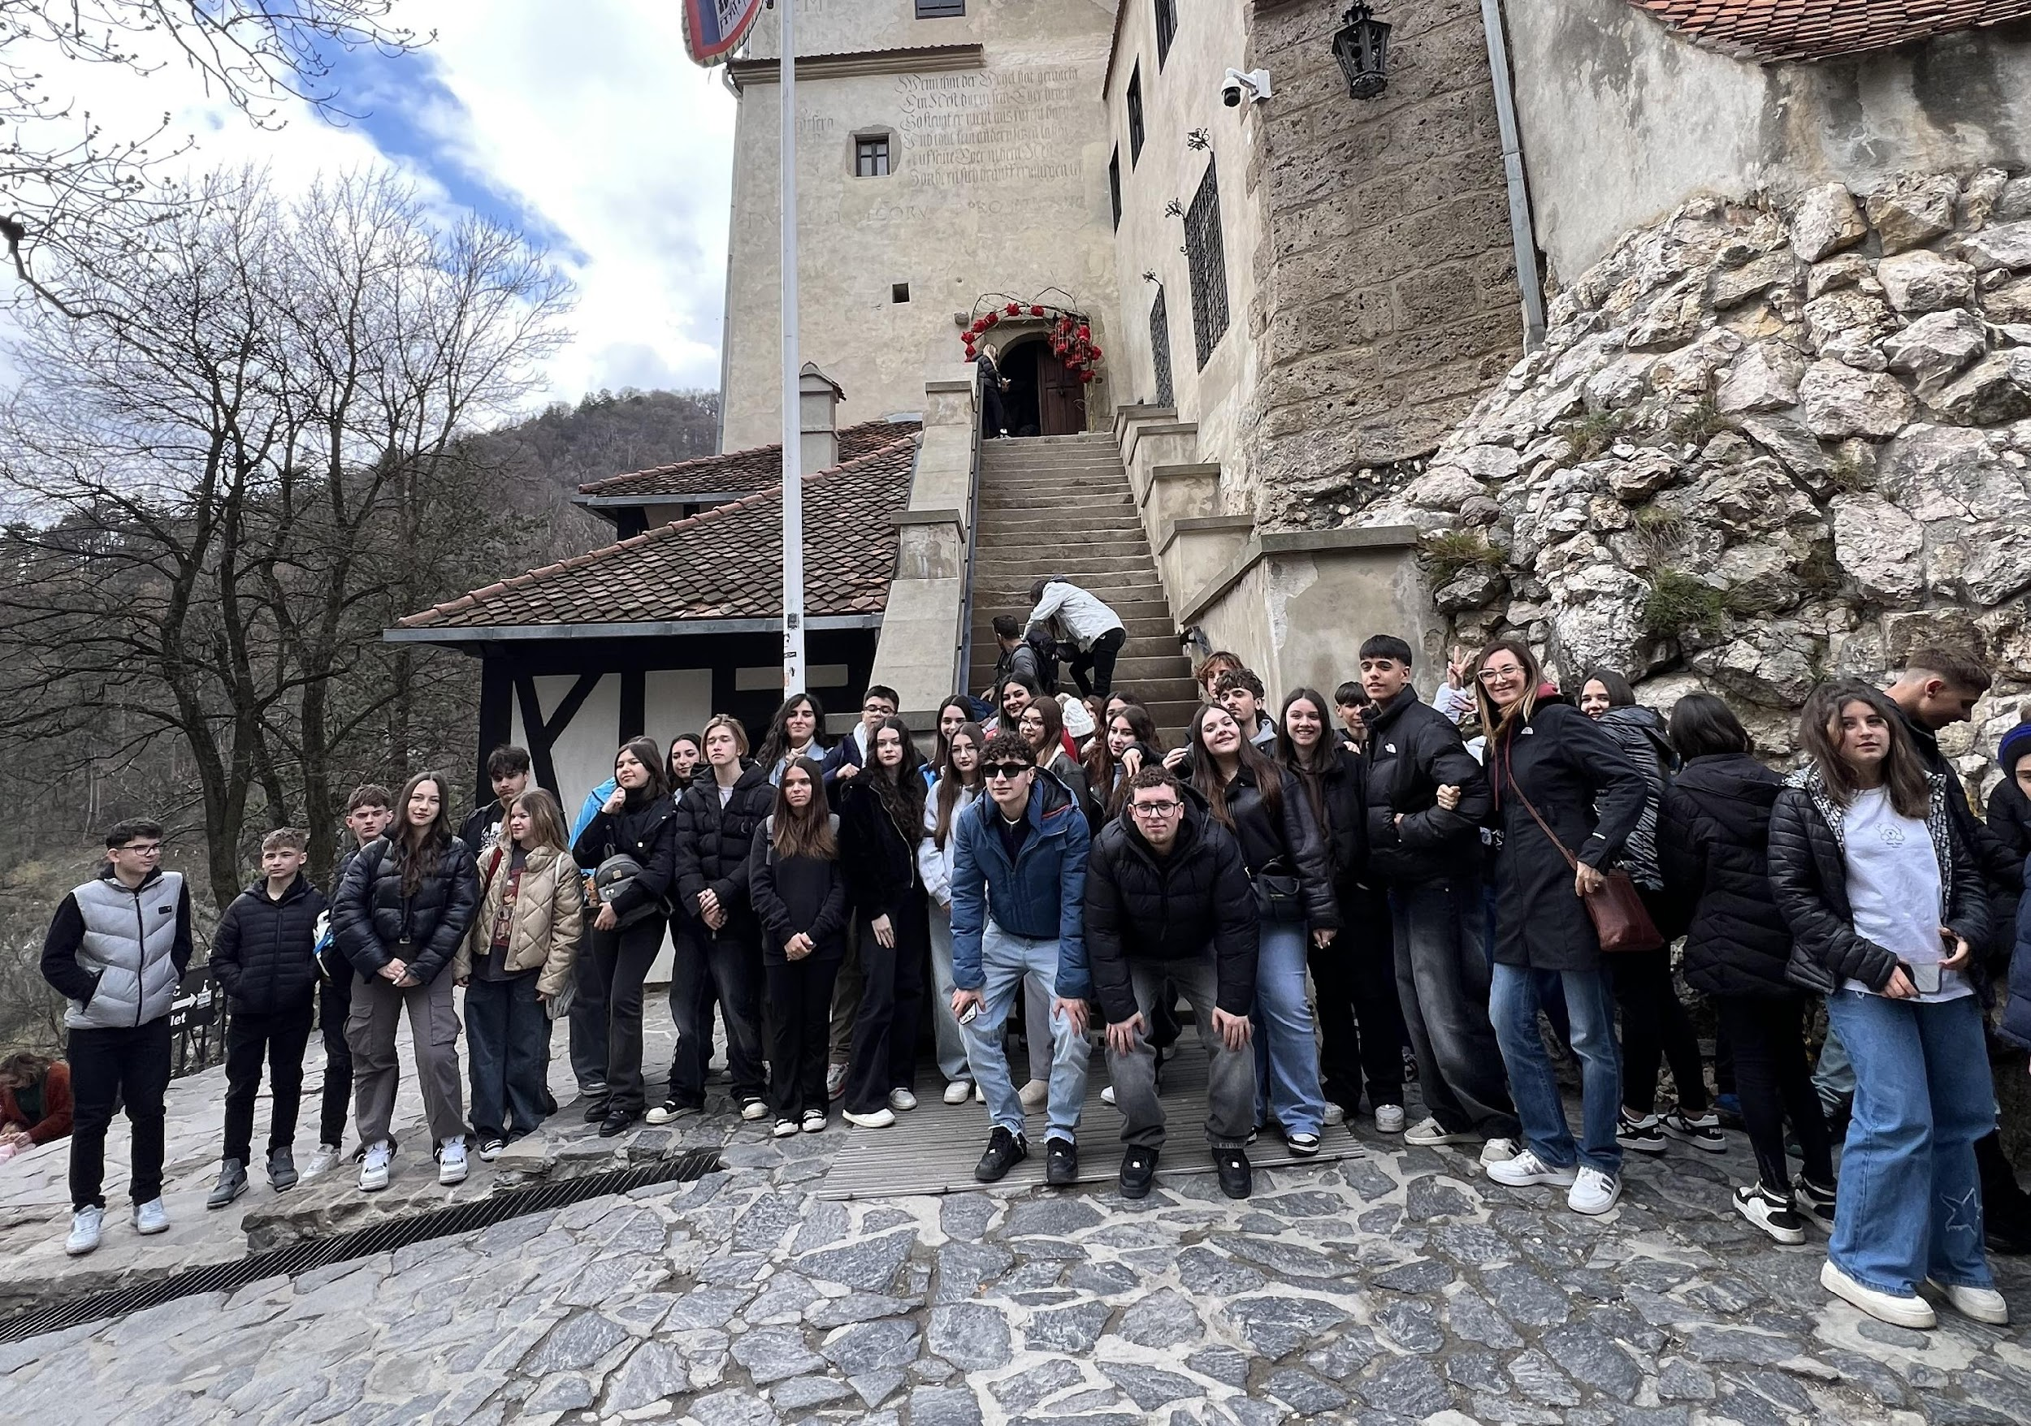
DAY 1 (5 APRIL)
On the first day, we visited Bran Castle,also known as Dracula’s Castle. The castle is located in Bran. Afterwards, we explored the city of Brașov. Then we had some free time to visit the city with a Romanian guide. They took us to Rope Street, the narrowest street in Brașov, where we stopped to take some photos. The walls were covered in graffiti, making it a very amusing spot.

Slide 3
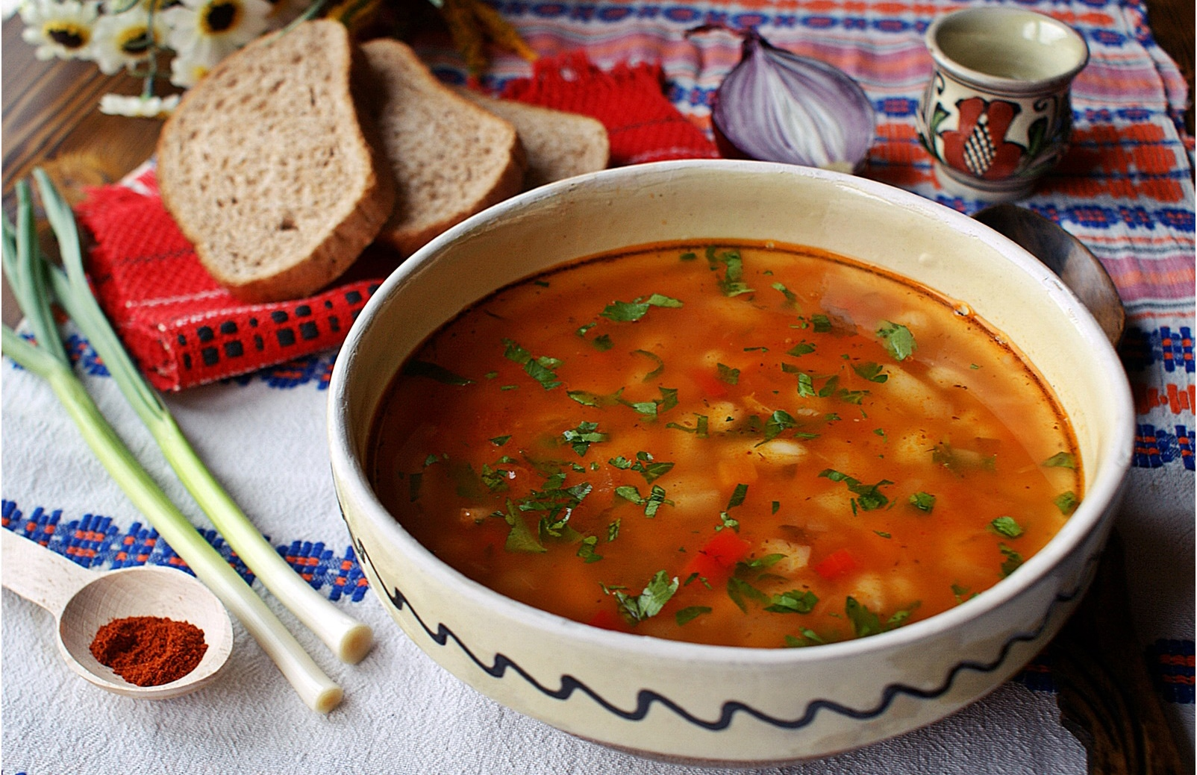
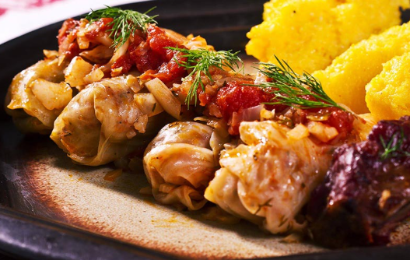
CIORBA DE FASOLE CU AFUMATURA
DAY 2 (6 APRIL)
The second day was Sunday, so we had the chance to stay at home with our host families and experience the Romanian family’s Sunday lifestyle. They cooked for us typical dishes from Romanian culture, like sarmale and ciorbă de fasole cu afumătură. It was a different experience for everyone, but surely very interesting. We also shared our cultural heritage and learned so much. We also brought something from Calabria to let them try something from our country.
SARMALE

Slide 4
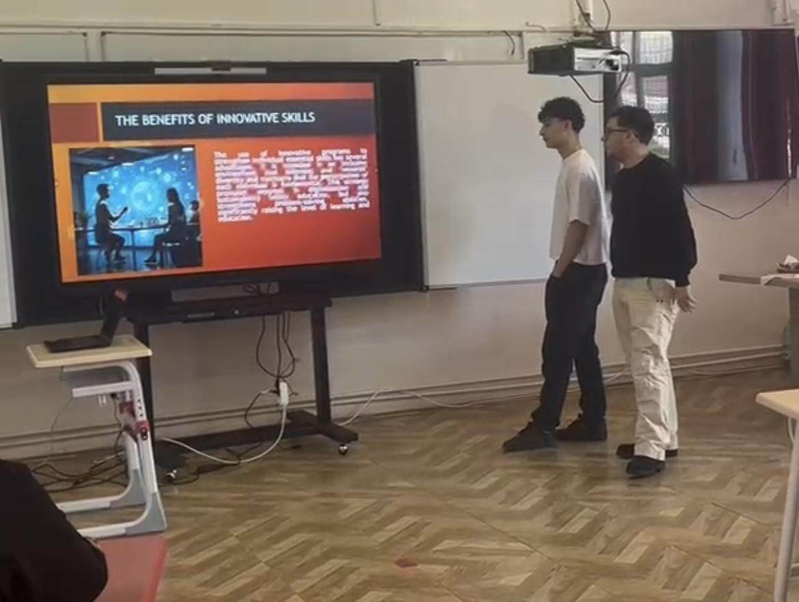
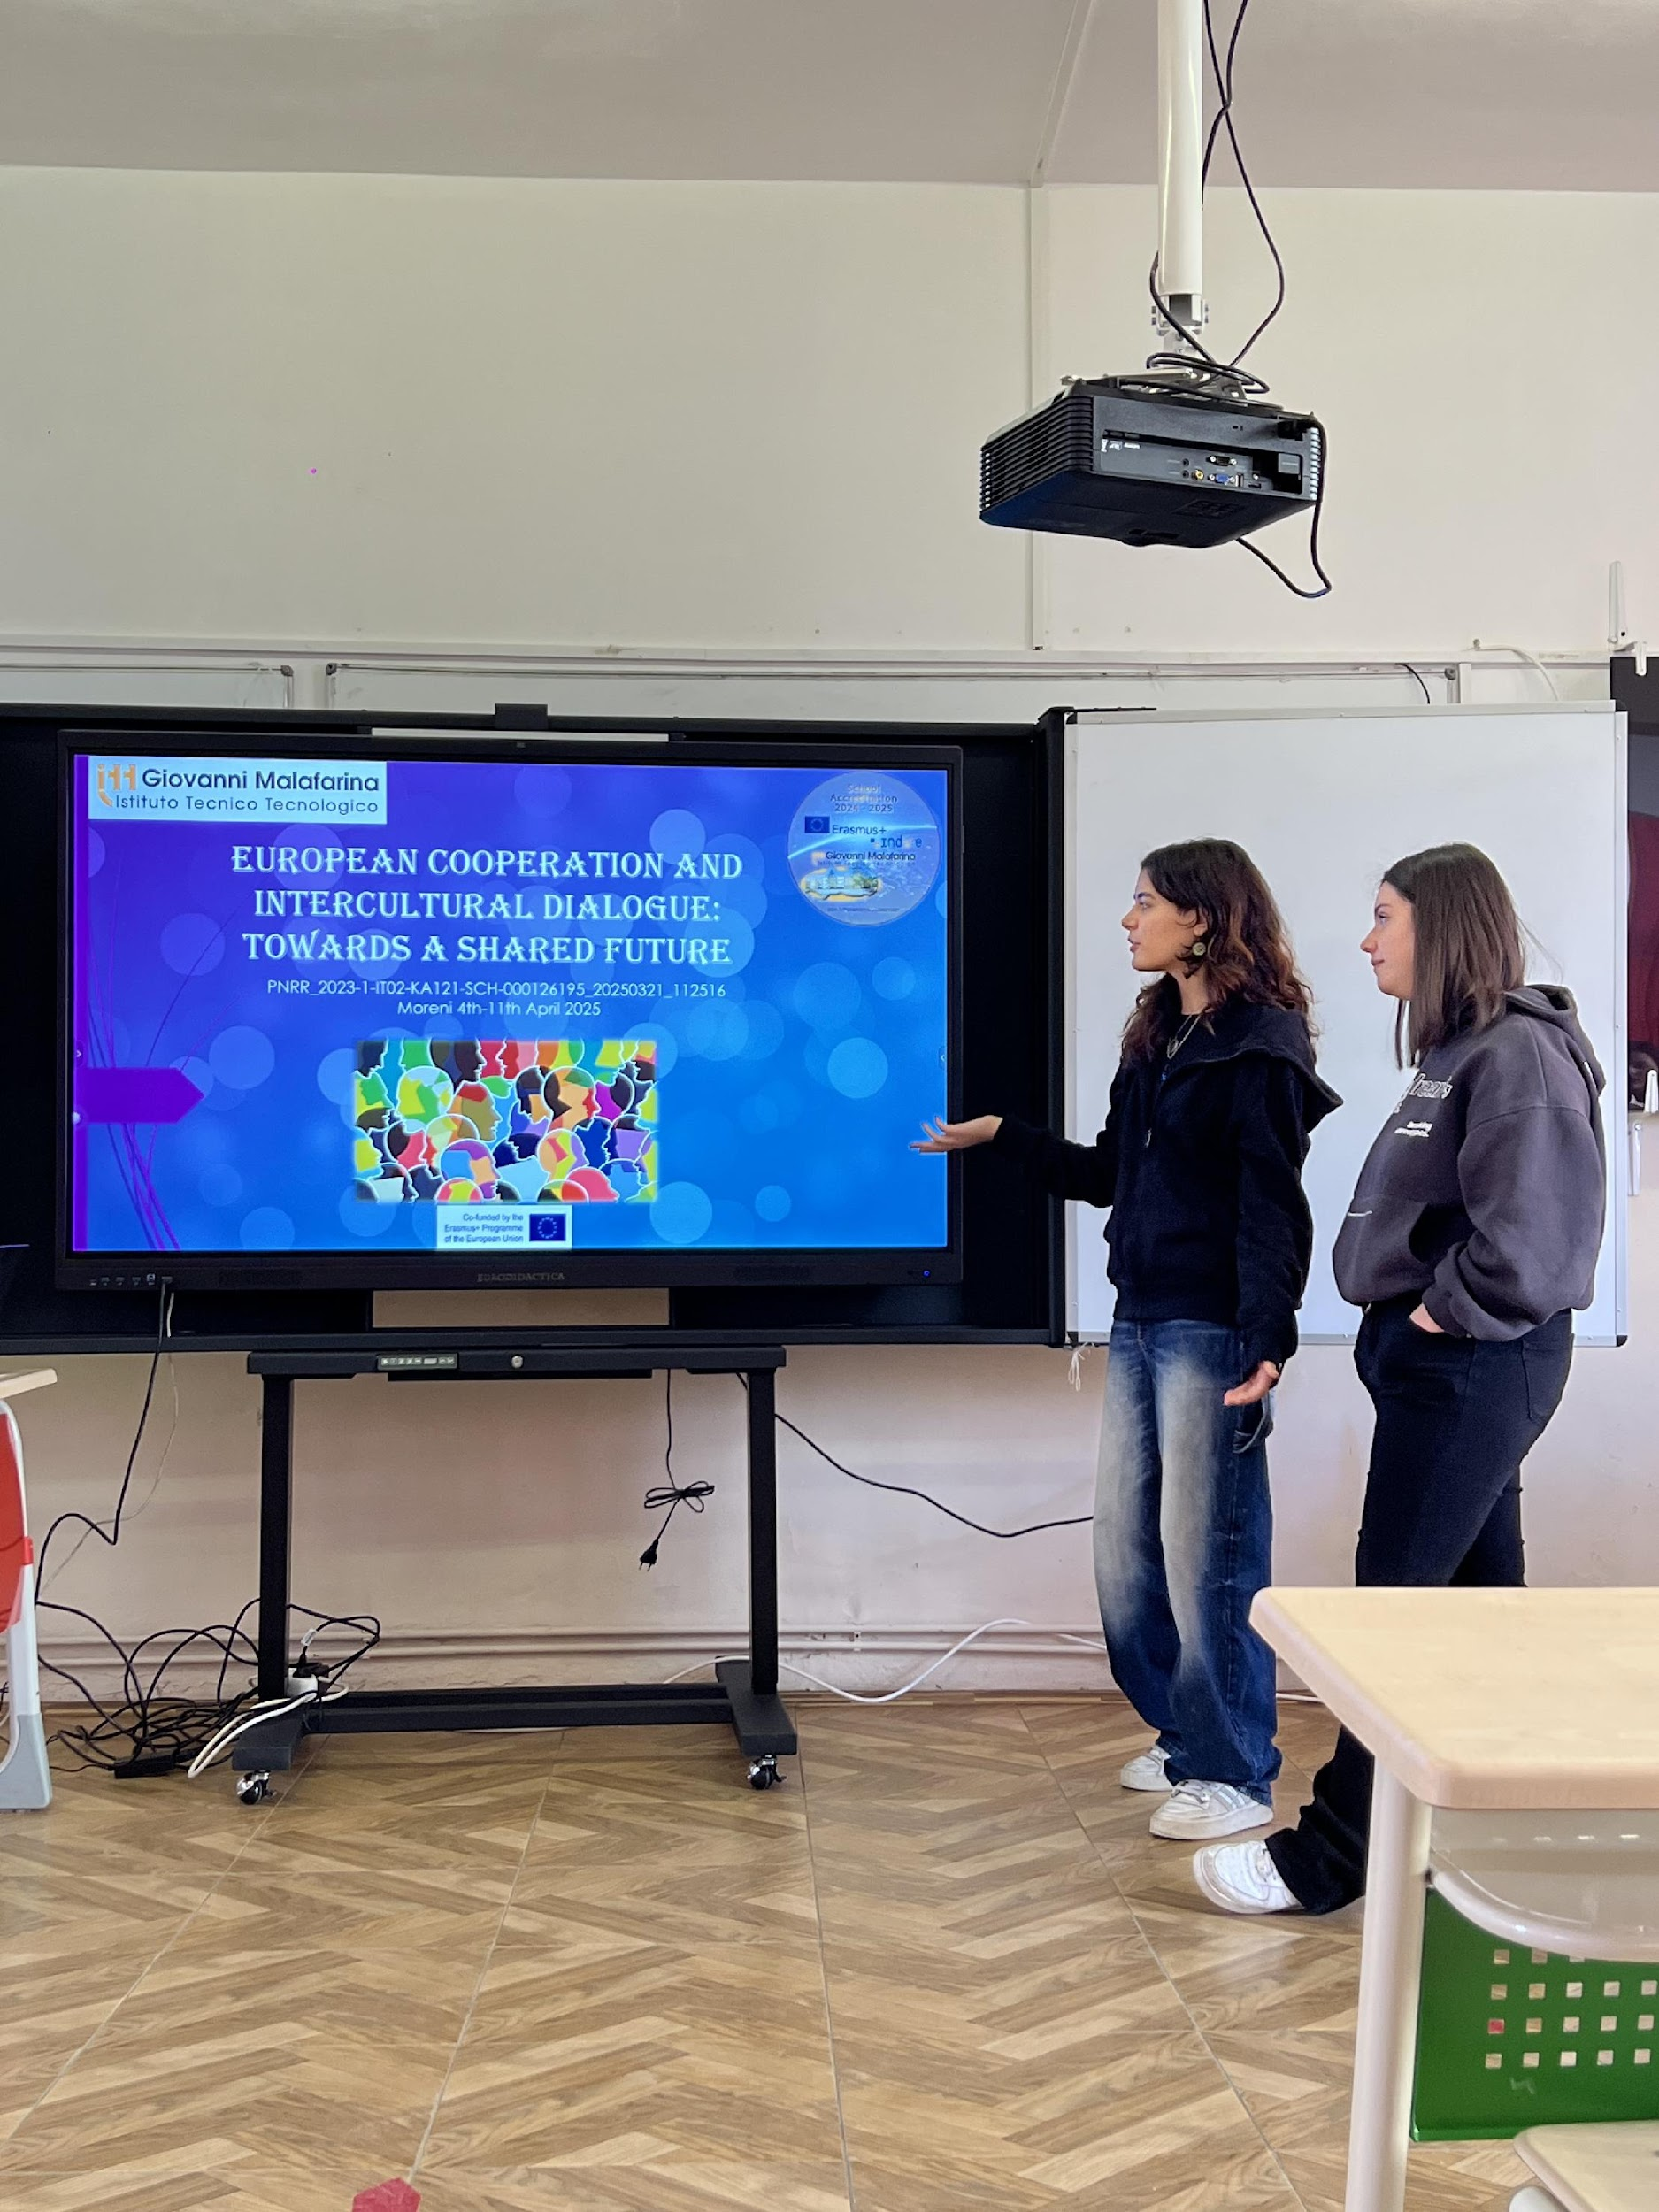
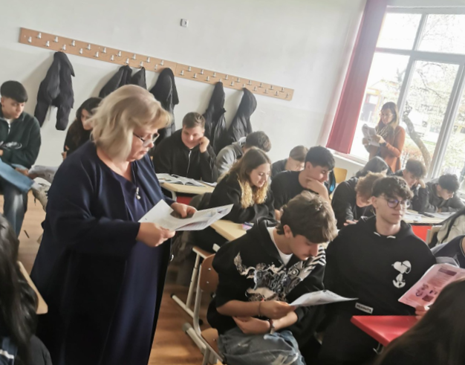
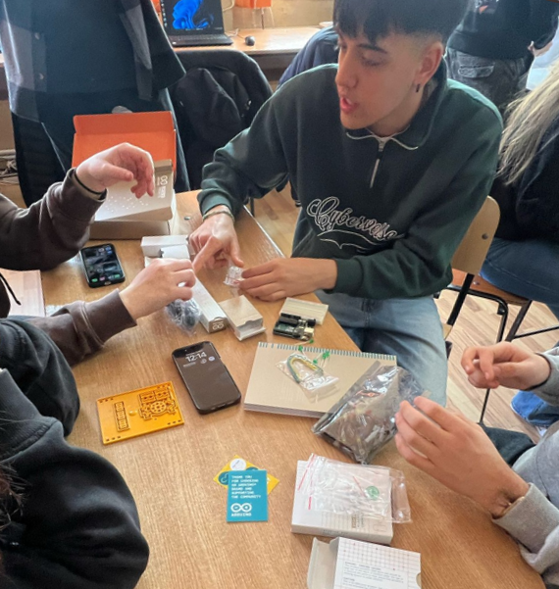
DAY 3 (7 APRIL)
On Monday, we went to school.
After the headteacher welcomed us warmly, we took part in many activities, such as IT and English lessons, presentations about European cooperation and Inclusion, and even some ice-breaking activities. The lessons were really enjoyable and very engaging, we had a great time. After school, we broke the ice a little more by playing and getting to know each other. We hung out all together and played many fun games.
Basic Skill Development for Inclusion
European Cooperation and Intercultural Dialogue: Towards a shared Cooperation

Slide 5
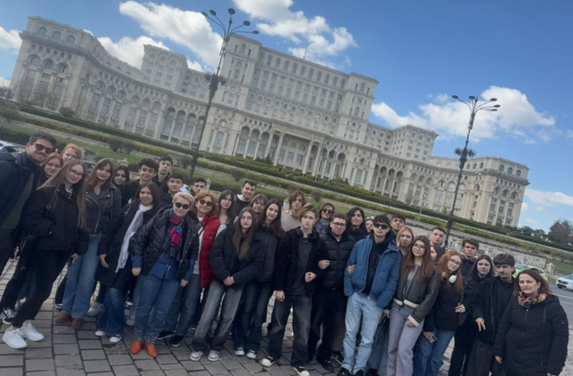
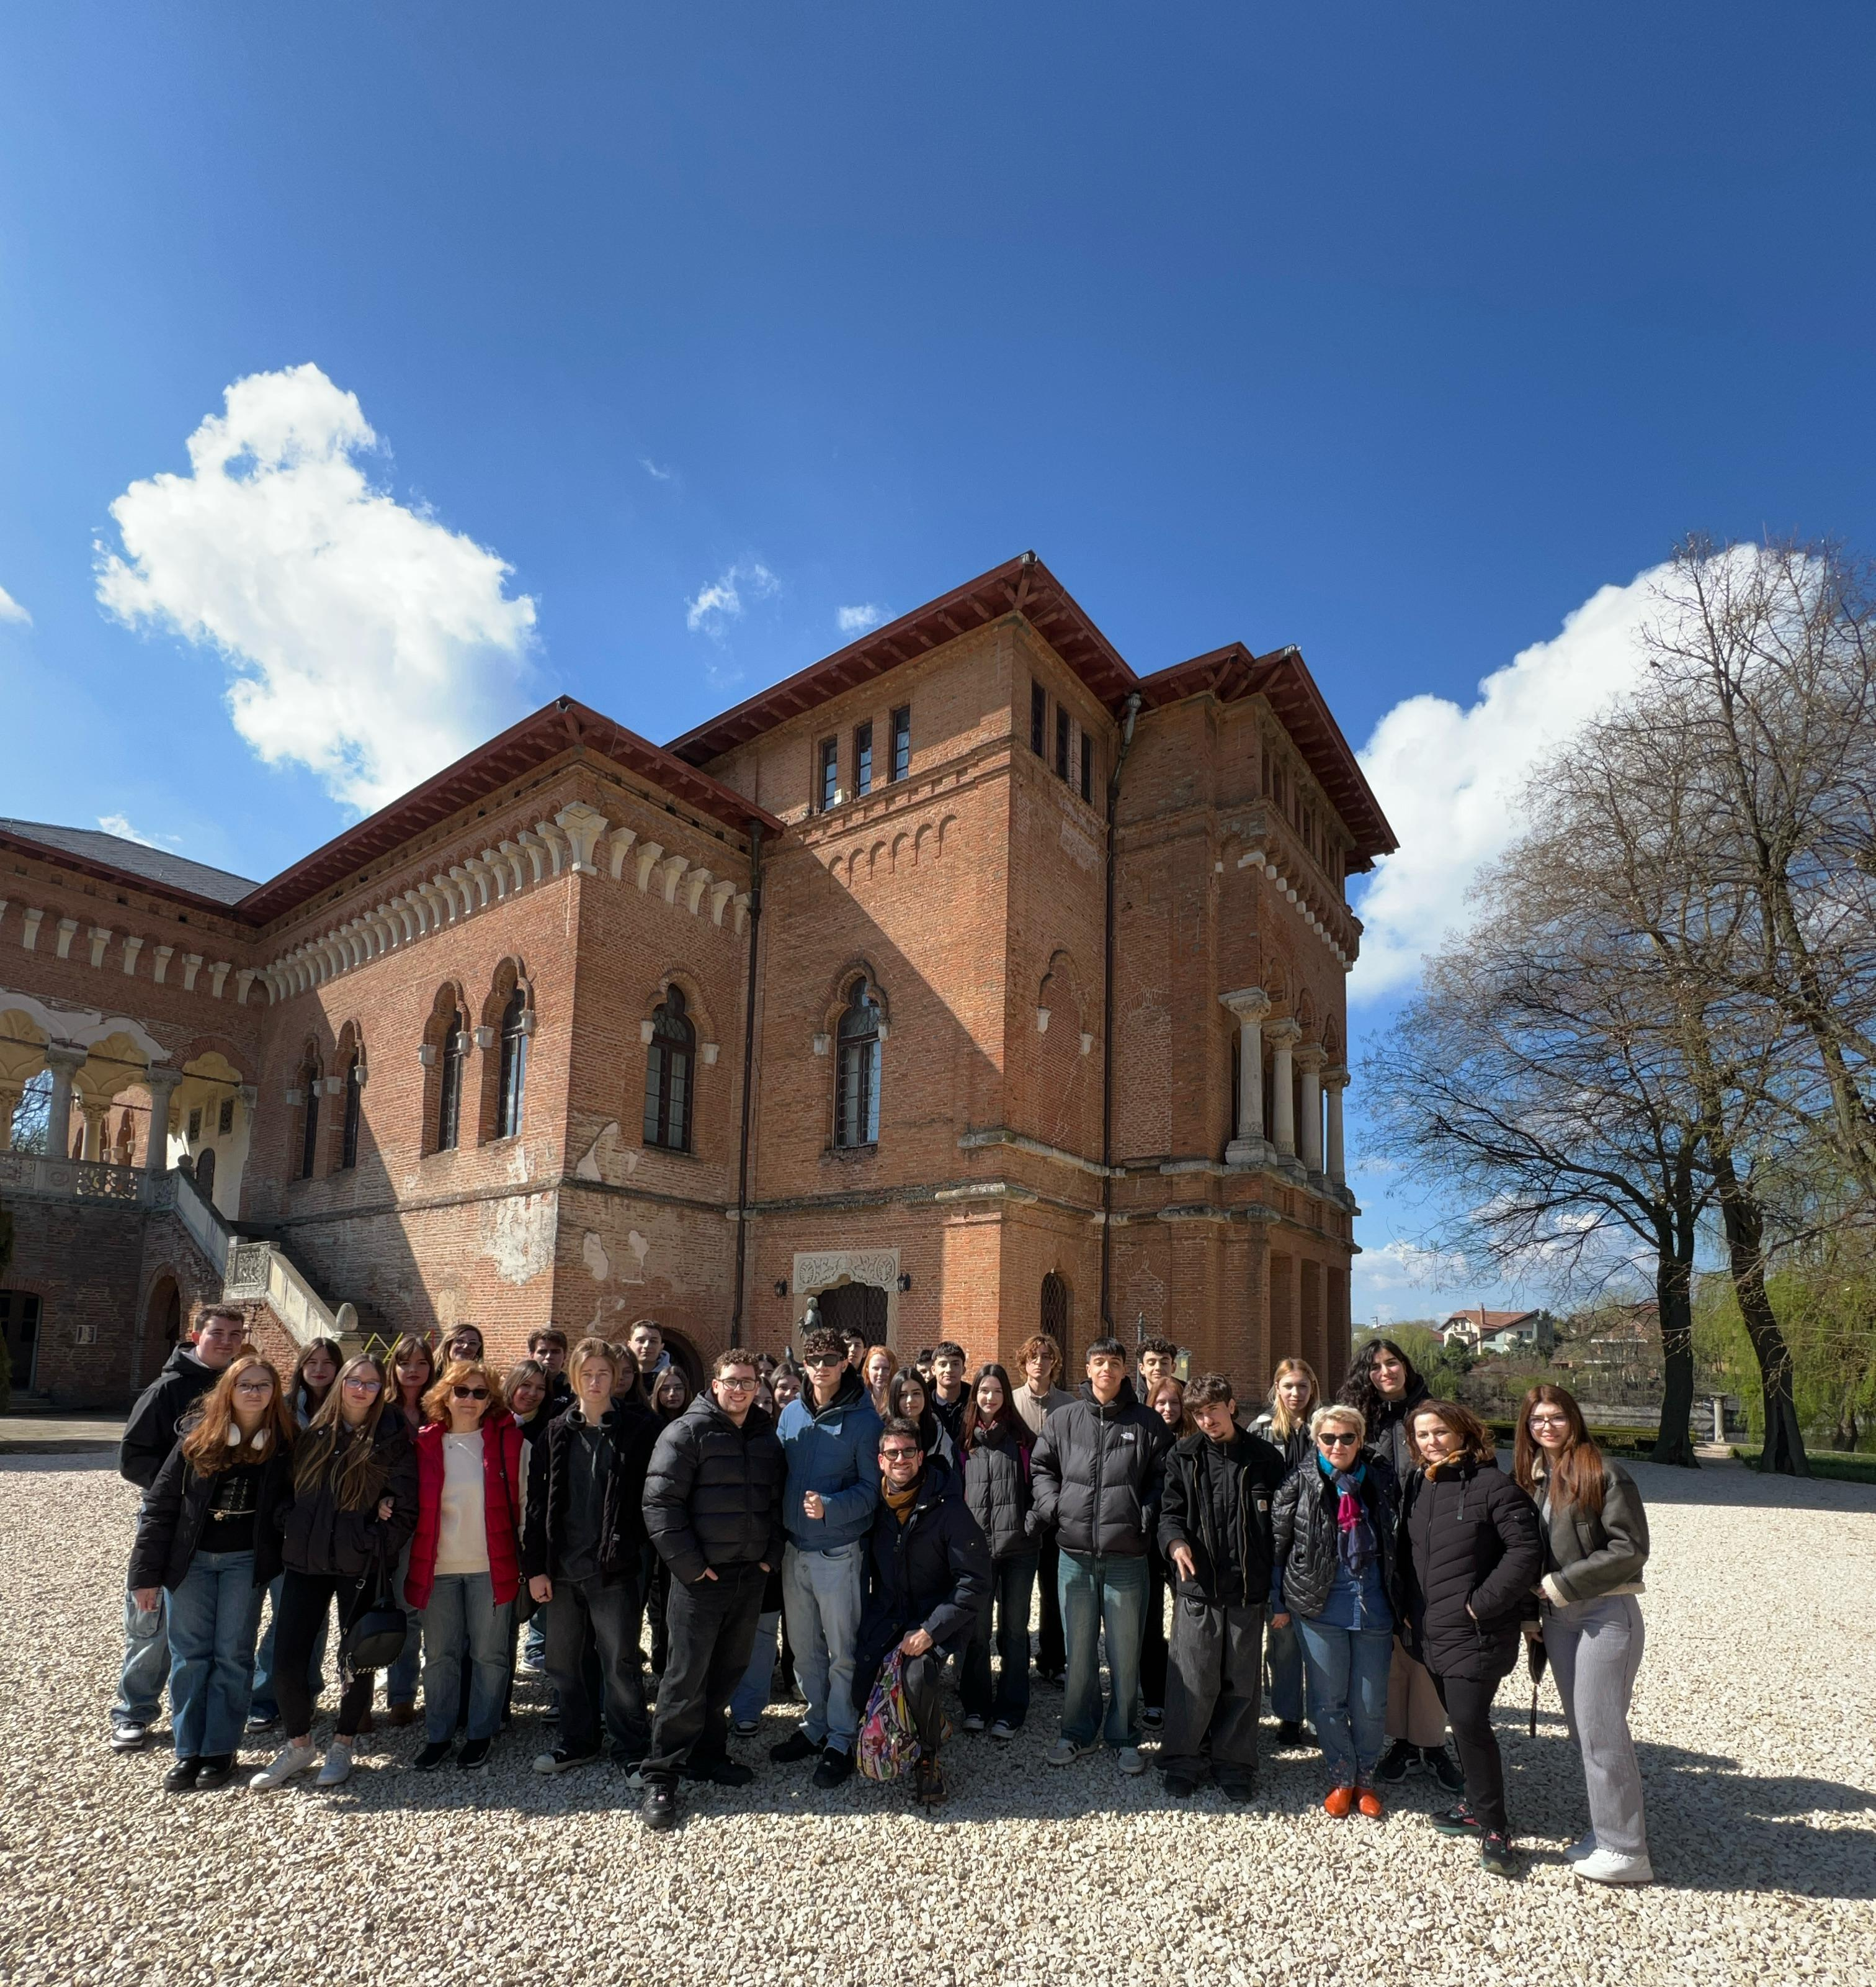
DAY 4 (8 APRIL)
On Tuesday we visited the city of Bucharest, the capital. We went to the Mogosoaia Palace before going to the Centre of the city, after that we visited the Triumph Arch, which was breathtaking. We then went to the House of Parliament. Eventually we visited the Old Centre and had a walk in the city.

Slide 6
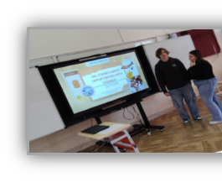
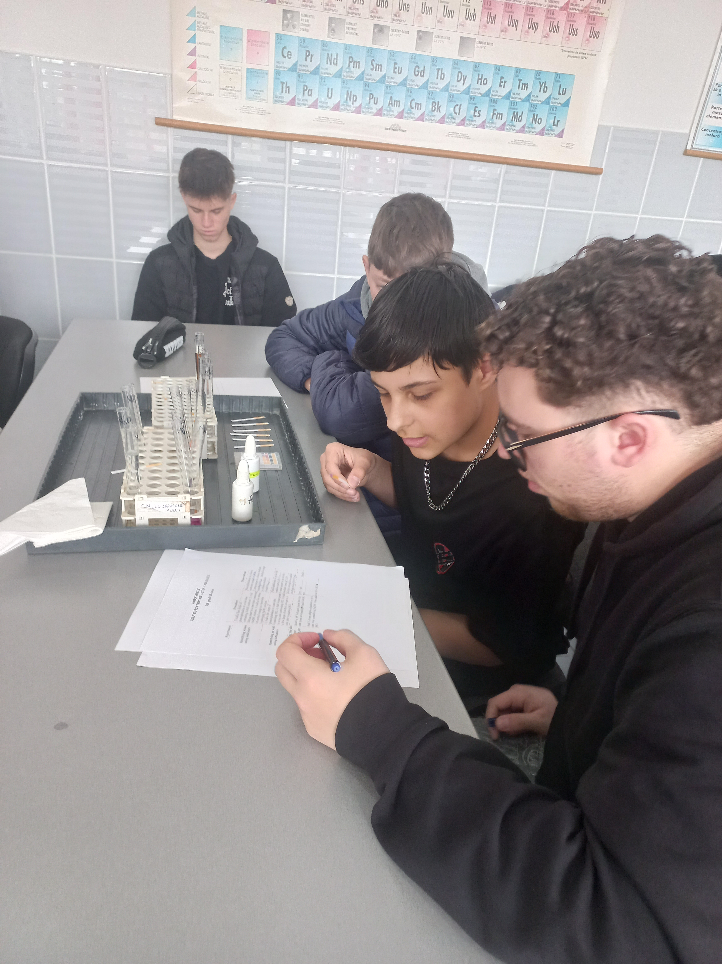
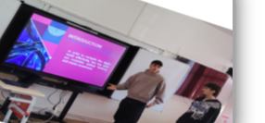
DAY 5 (9 APRIL)
The sixth day was spent in school, in which we had classes and activities. We presented topics about Critical Thinking and Media Awareness and about Unlocking Career Opportunities with Erasmus Programme.
The IT lesson focused on controlling a servo motor, and the English lessons were about friendship and the internet.

Slide 7
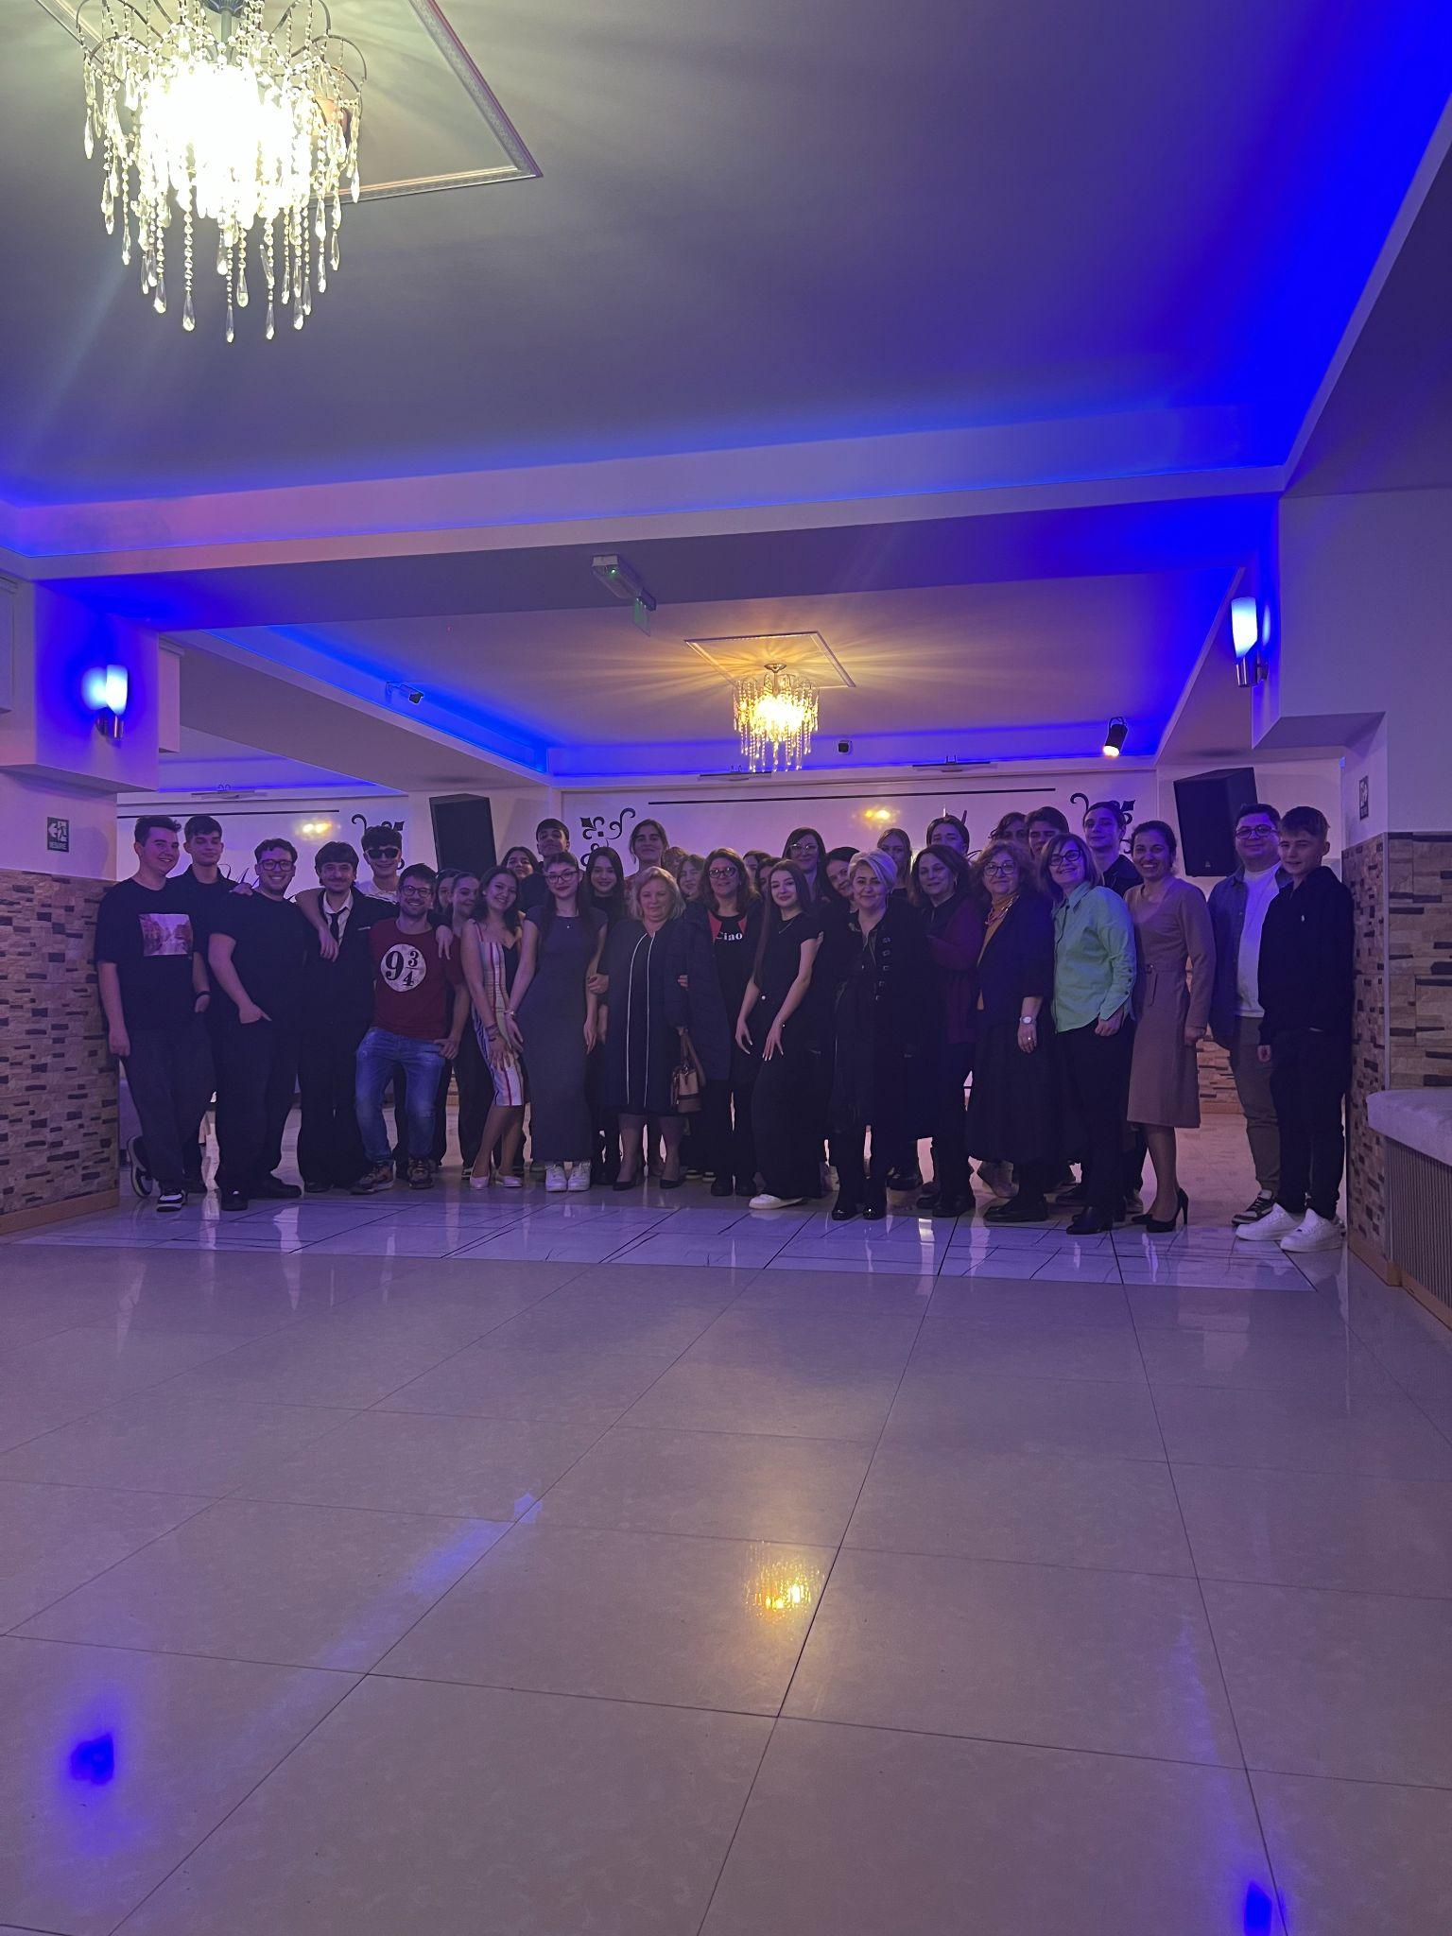
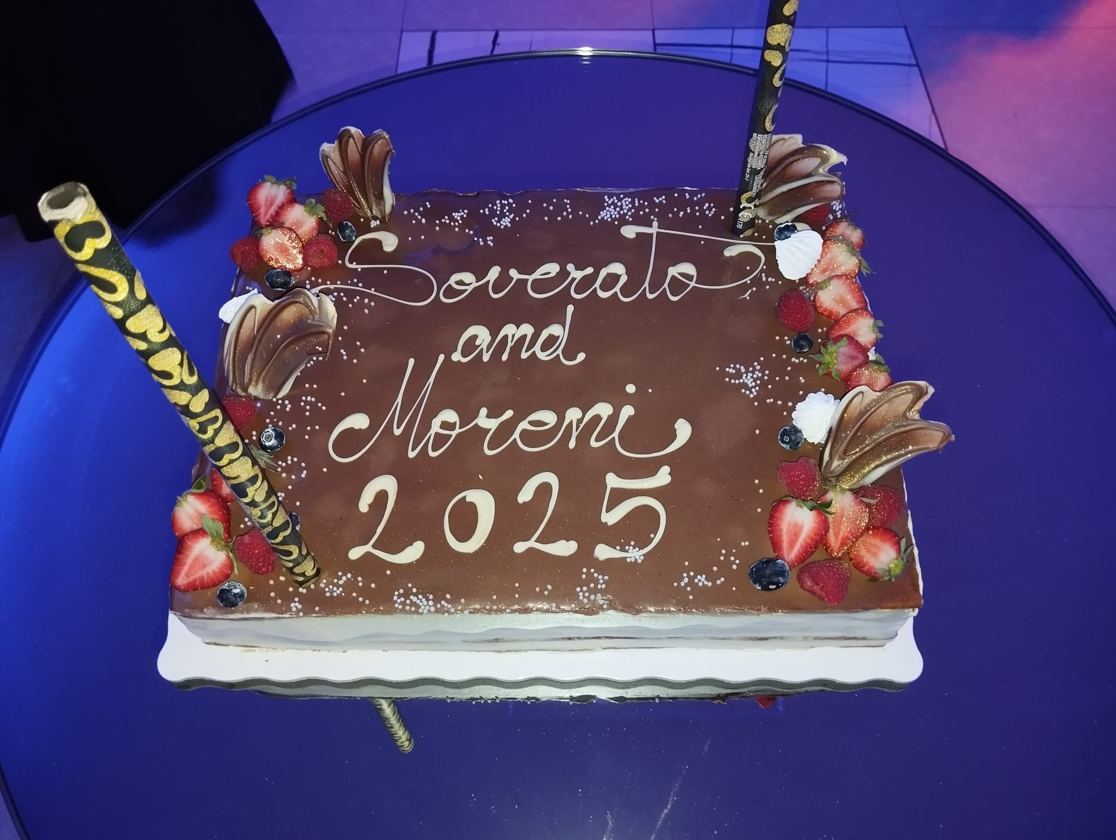
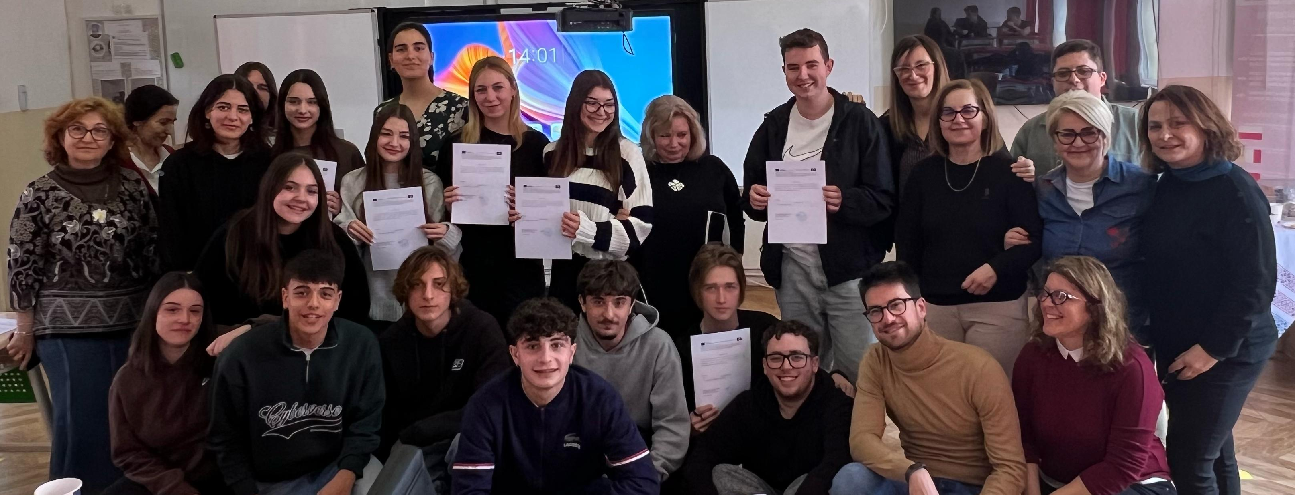
DAY 6 (10 APRIL)
In the seventh day we had our last activities, and they were about: IT, english class in which we talked about water in different areas, from art to music and dance. Afterwards, we had another english class about careers, business and professional skills. After that we had our first chemistry class where we mixed different liquids and noted the Ph. We presented the last workshops, they gave us the certificates and got back home. In the evening we had a lovely farewell party, we danced and had a lot of fun with our Romanian friends for the last time.

Slide 8



