Slide 1





TEACHING ACTIVITY
Prof. Marco Anania
PNRR_2023-1-IT02-KA121-SCH-000126195_20250321_112516
Moreni 5th-10th April 2025

Slide 2
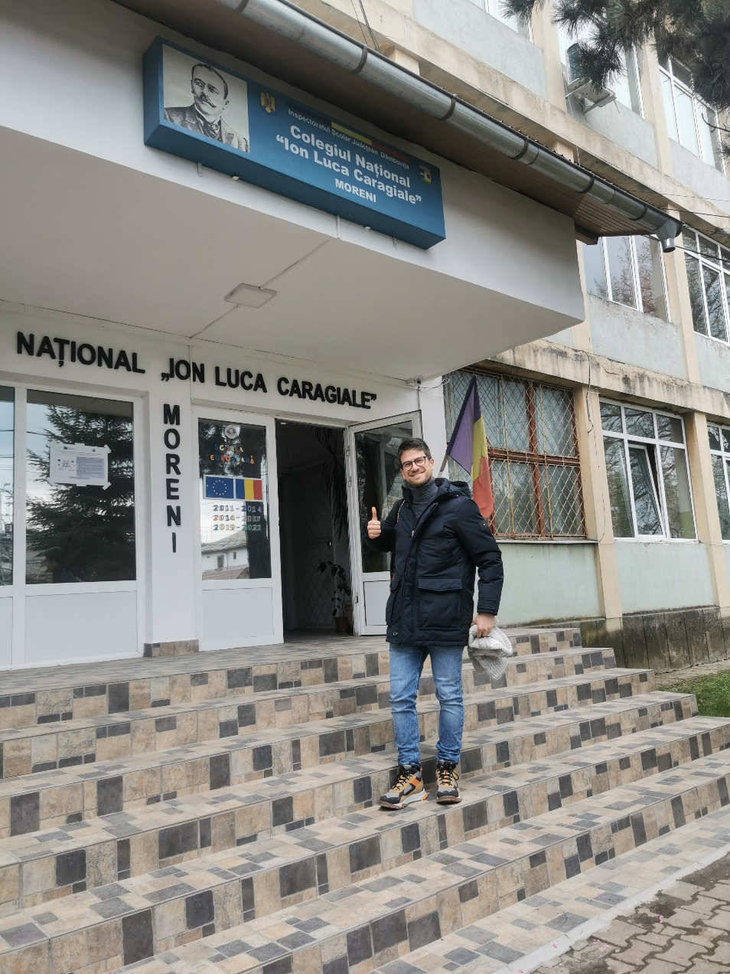

PNRR ERASMUS – ITT MALAFARINA
The teaching activity plan:
Use of CANVA
Videogames Project Management
Discussion about videogames development
Responsible using of Social media
Colegiul National «Ion Luca Caragiale» Moreni
2023-1-IT02-KA121-SCH-000126195
2024-1-IT02-KA121-SCH-000213329

Slide 3
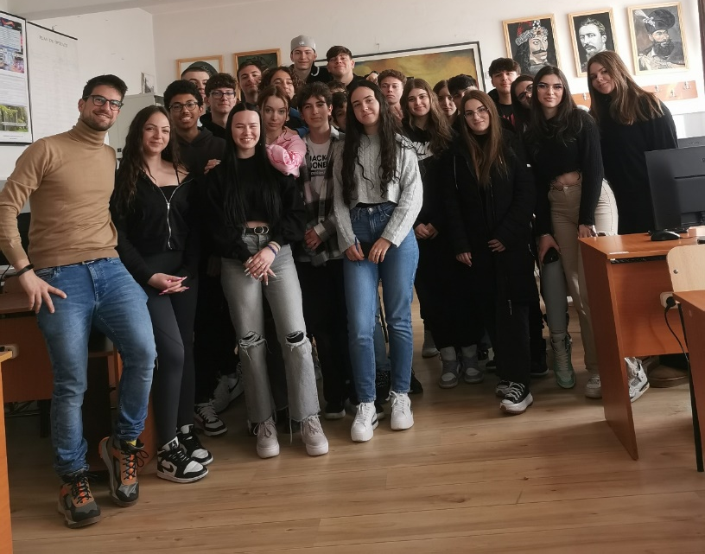
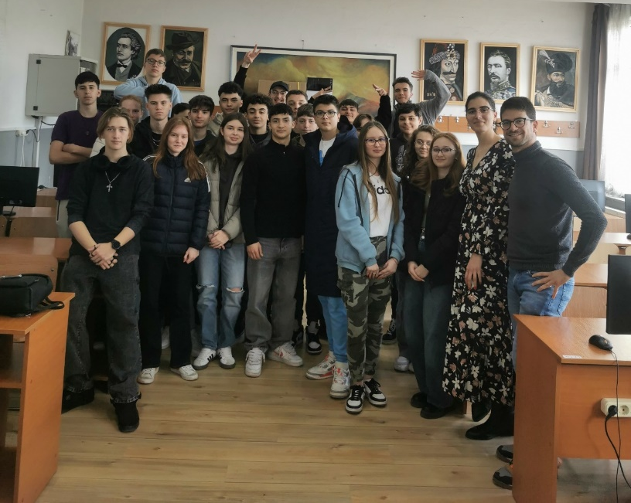
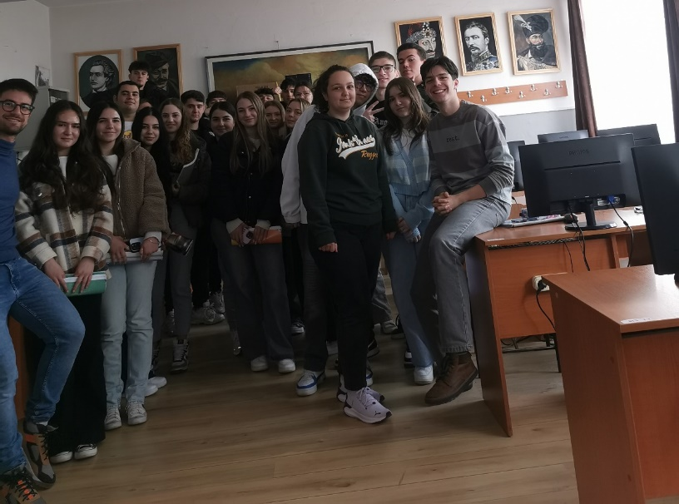
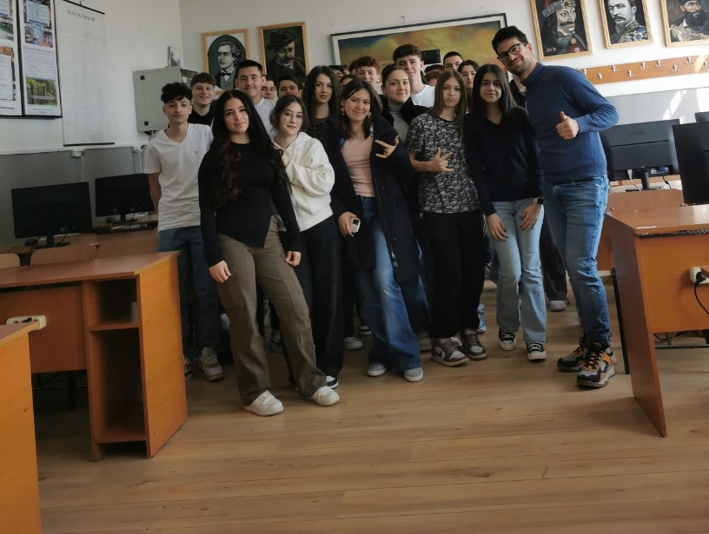
PNRR ERASMUS – ITT MALAFARINA
MY 4 CLASSES
2023-1-IT02-KA121-SCH-000126195
2024-1-IT02-KA121-SCH-000213329

Slide 4
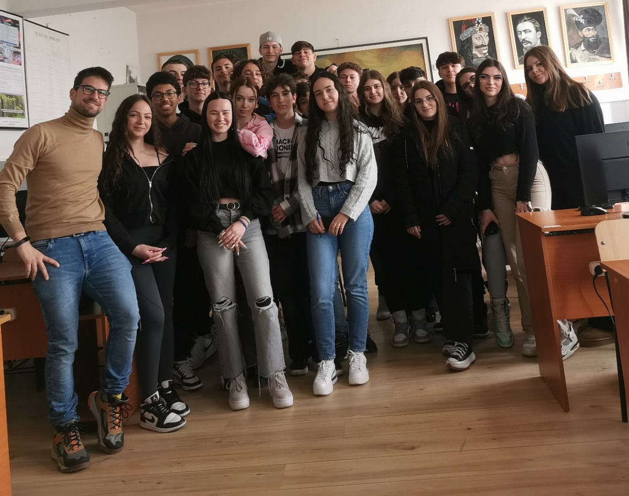
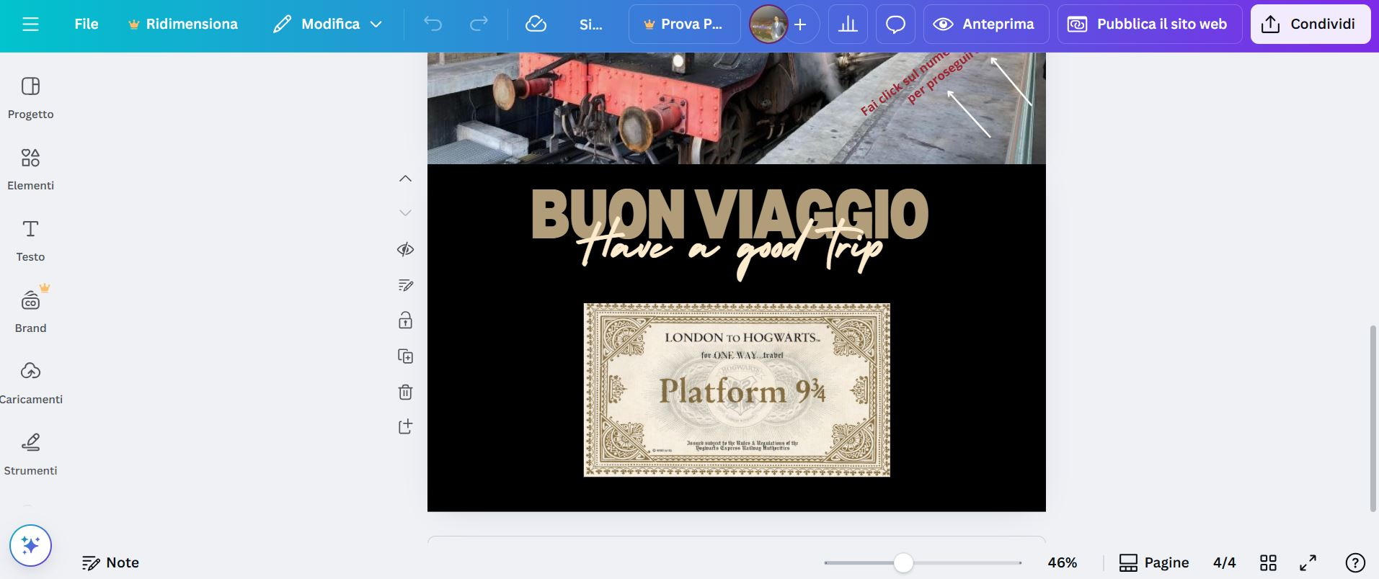
PNRR ERASMUS – ITT MALAFARINA
Use of CANVA
Learn to make slides, websites and posters with Canva.com
1st class
2023-1-IT02-KA121-SCH-000126195
2024-1-IT02-KA121-SCH-000213329

Slide 5
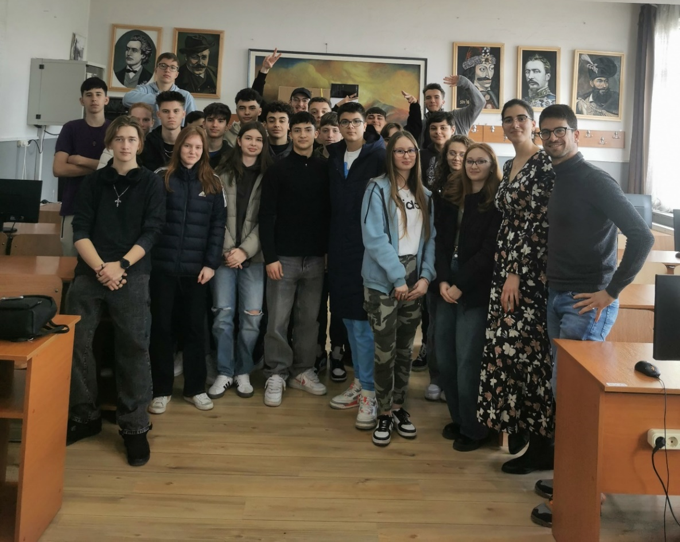
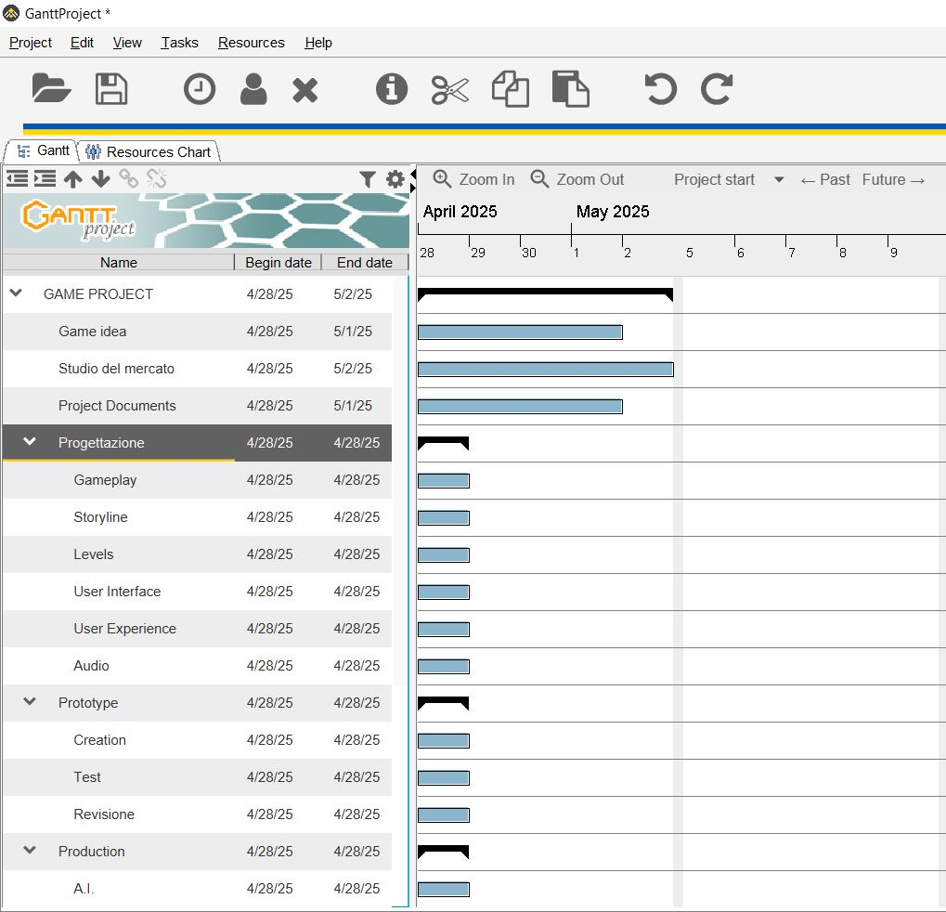
PNRR ERASMUS – ITT MALAFARINA
Videogames Project Management
Gantt Diagram, Project Management and Videogames activity
2nd class
2023-1-IT02-KA121-SCH-000126195
2024-1-IT02-KA121-SCH-000213329

Slide 6

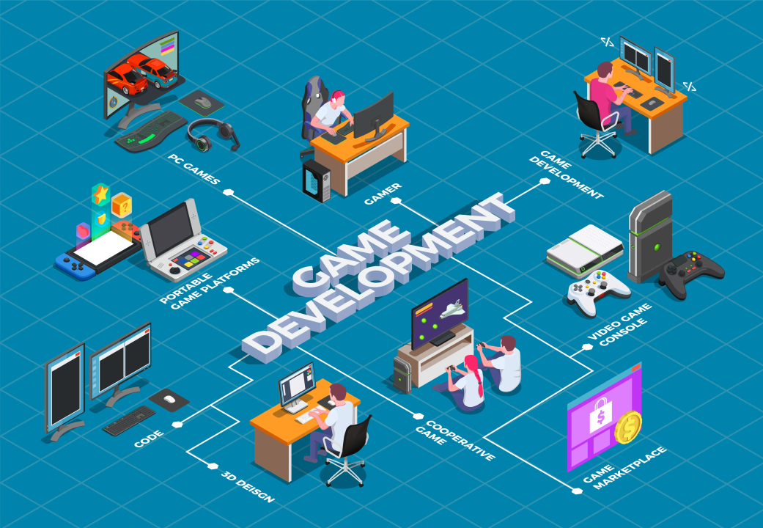
PNRR ERASMUS – ITT MALAFARINA
Discussion about videogames development
Cooperative learning and brainstorming
about videogames development
3rd class
2023-1-IT02-KA121-SCH-000126195
2024-1-IT02-KA121-SCH-000213329

Slide 7


PNRR ERASMUS – ITT MALAFARINA
Responsible using of Social media
Interactive lesson about social media:
pros and cons
the psychology behind the algorithm
4th class
2023-1-IT02-KA121-SCH-000126195
2024-1-IT02-KA121-SCH-000213329

Slide 8
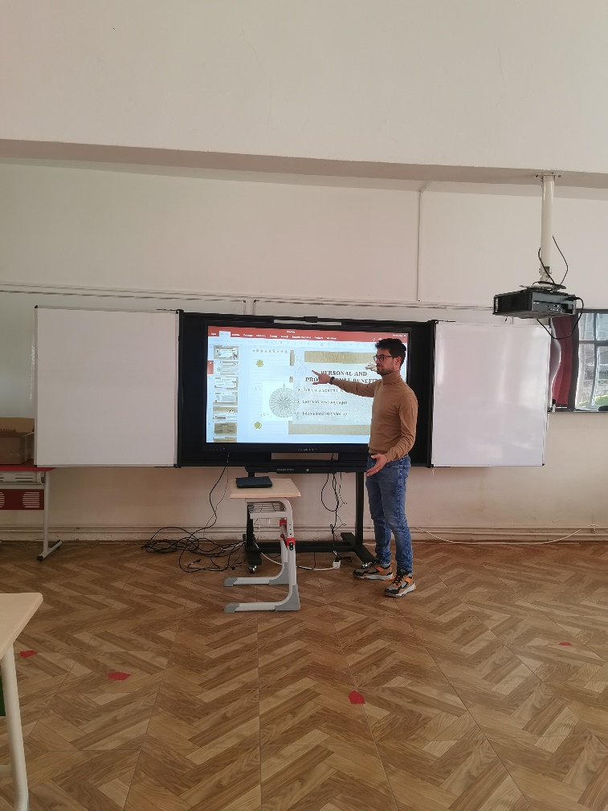
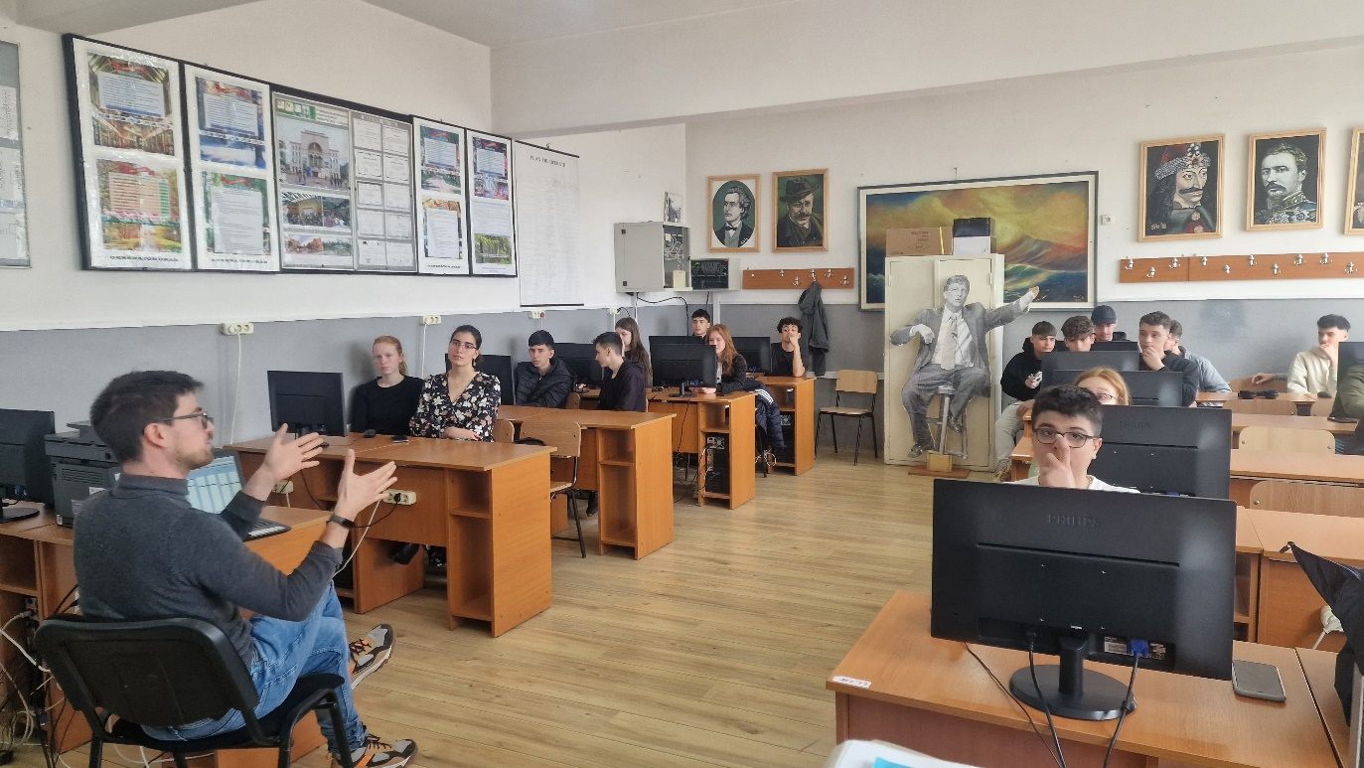
PNRR ERASMUS – ITT MALAFARINA
THANK YOU FOR THIS WONDERFUL EXPERIENCE
2023-1-IT02-KA121-SCH-000126195

