Slide 1


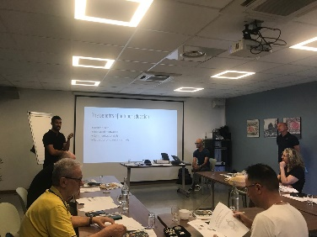
LOGbook
Reunion Islands
Action in Reunion
Course
March 10 to March 14- 2025

Slide 2
Techniques of video Making
Integrating tools for
■ being aware of the innovative opportunities
■ Increasing learners’ motivation
The basics of framing
Position of phone
The rule of 1/3
Scales
CAPCUT
How to run a video project!
The writing part is essentially
based on Wh questions:
What (theme)
Why (aim)
Who (characters)
Where (location)
When (time of the movie)
+
How : tools needed
Tutorial :
https://www.capcut.com/tutorial
https://www.youtube.com/watch?v=pHMoPh6mzm4

Slide 3
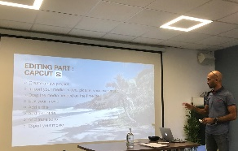
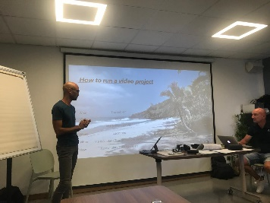
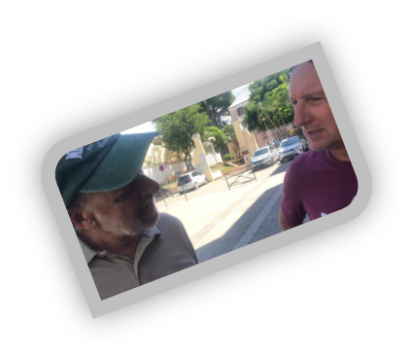

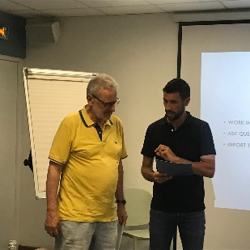
Videointerviewing local people
making a video about diversity in Reunion
Specifications:
• 3 minutes maximum
• Use the basics of framing filming technics
• One Interview of a local citizen
• Use the voice over in your project film
• Use a free music
• Use a free software for the video editing

Slide 4
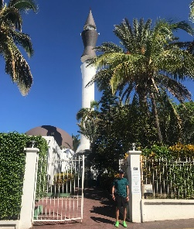
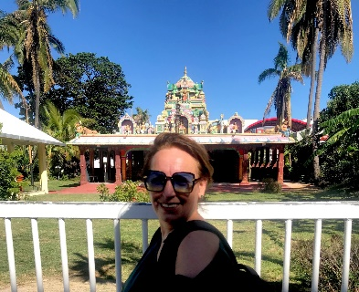
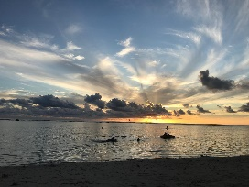
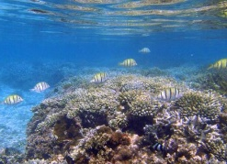

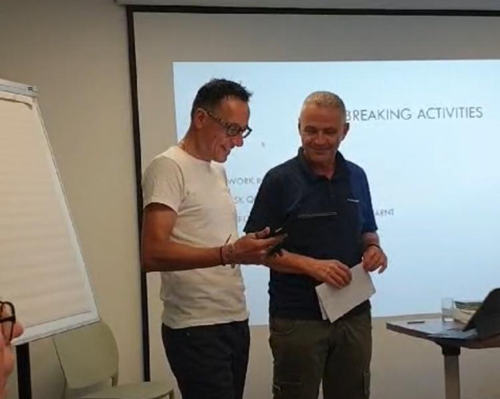
shots
Tips:
• Use the grid on your camera
• Use different scale of plan (overall plan for monuments, chest close-up for interview, low angle shot…)
• For the interview, let the camera roll and ask several question, you will keep the best when you get to the editing part
• Always take two shots of the same scene and choose the best one when editing

Slide 5
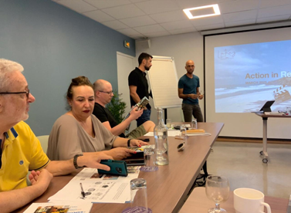
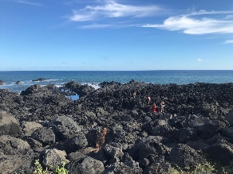
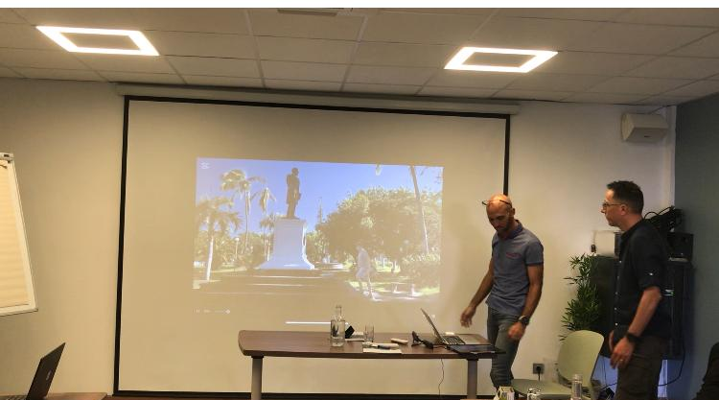
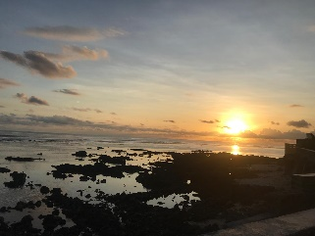

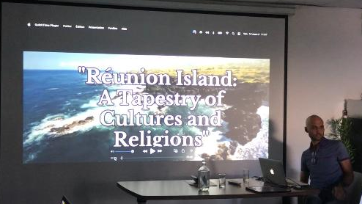
Editing techniques
In the editing part, prefer a lot of short plans (2/3 sec max) for a static plan. Movement plans (panning or travelling) can be longer.

Slide 6
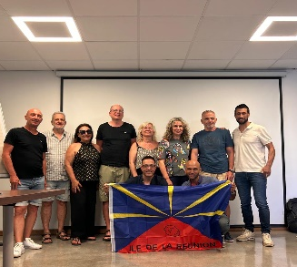
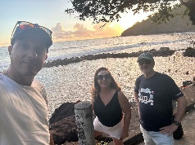

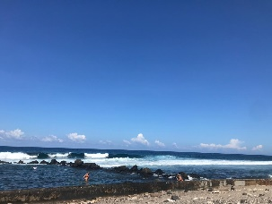
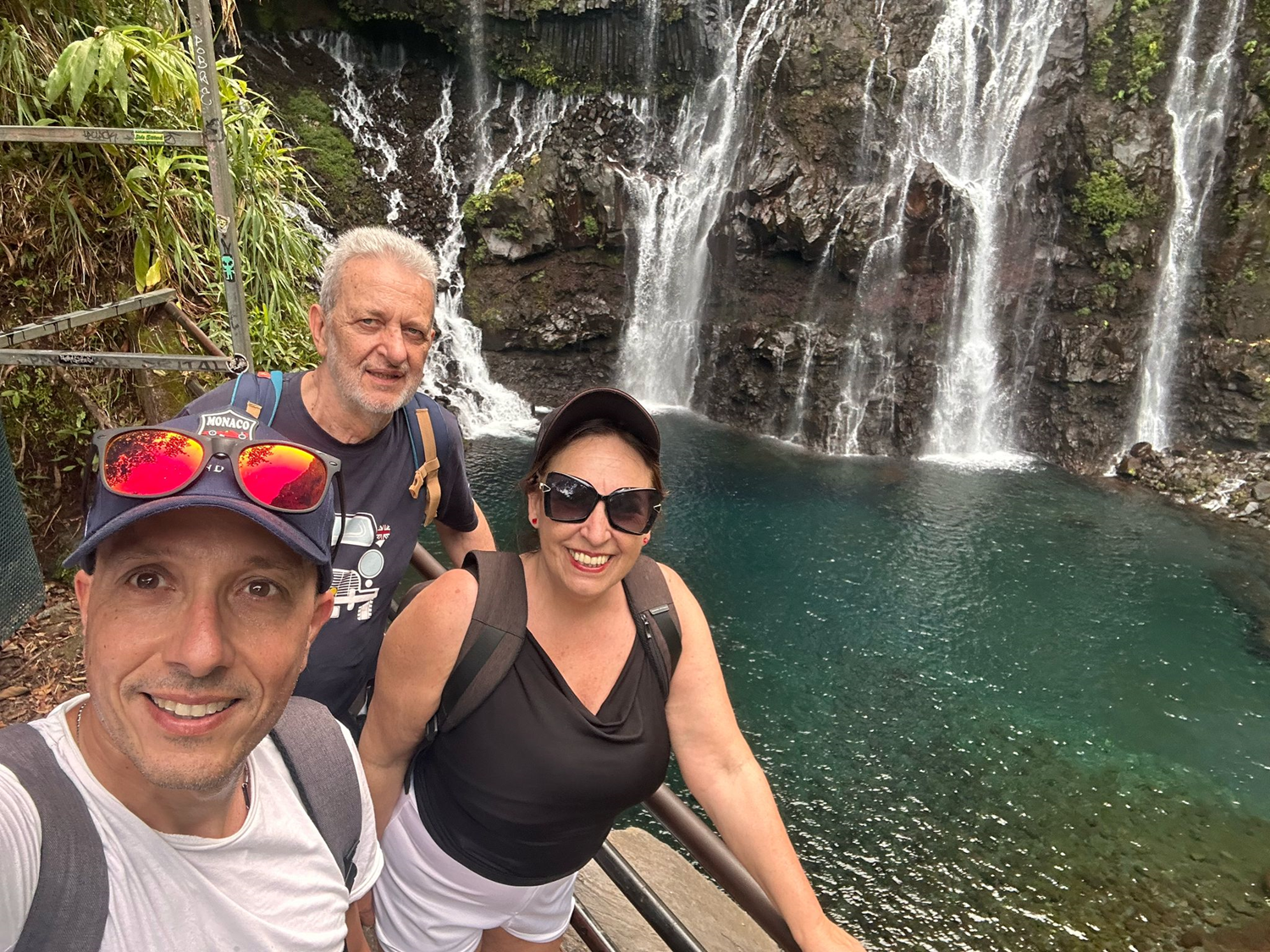

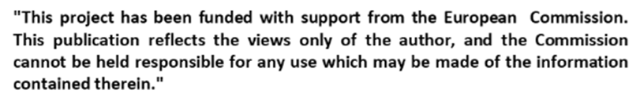
Thanks for watching
Andrea Natali
Claudio Cherubino
Savina Moniaci

